Slide 1

Smart Health Consultation Center
Management System
Section : 02

Slide 2
Group Members:
Raunaq Tabbassum : 2017-2-60-021
Md. Hasan Imam Shihab : 2018-1-60-070
Razoana Ayshee : 2018-1-60-229

Slide 3
Problem Statement:
Health is precious to all of us. When someone gets sick they always go to visit a doctor at the hospital. Hospitals usually store patients' medical records. In the conventional system if you want to collect some medical history of yours then you have to physically go to the authority and then you can collect your required data from the authority. It is difficult to take a doctor's appointment by going to the hospital physically or through the phone call. If somehow you lost your prescription or doctor’s written advice document then it is difficult to restore those documents. We can not remember every detail about our previous medical history so that in some cases this hampers the perfect treatment for future diseases. Before taking appointments by going physically, a patient can not access doctor’s information perfectly from the given information that makes a patient confused who is the best doctor for them for a particular problem. If the appointment schedule is changed all patients can not get informed immediately , consequently they will go for an appointment which is a waste of time and sometimes the number of patients may exceed the doctor’s capacity to examine. So the extra patients might have to return without seeing their doctor. Also patients can not easily cancel their appointment if they want. Doctors can not access patients information immediately if they are needed when they stay out of their chamber. Whenever you go to a doctor's chamber then you must carry previous documents to the chamber related to your health and sometimes you forget to carry those important documents. It is easy for a doctor to prescribe wrong medicines because the data of a prescription is not stored anywhere.

Slide 4
Proposed Solution:
We are going to design A Smart Consultation Center Management System which will have all the feature solutions for the problem.
This website will help doctors to give service properly and also it will help patients to get a doctor’s service more appropriately and comfortably.

Slide 5
Functional Requirements:
Patient Signup.
Patient Login authentication and Login.
Patient profile editing by patient.
Show patient profile.
Admin login authentication and Login
Insert Doctors Information by Admin.
Doctor’s Login authentication and login.
Showing Doctor Profile to doctor.
Doctor Profile edit by doctor.
Insert Doctor’s Designation.
Patients can see all doctors’ information
Consultation Center information inserted by admin.
Patients can see the consultation center’s Information.
Appointment Time slot inserted by admin.
Doctors can choose how many days they want to sit in their chamber.
Create an appointment option.
The patient will be able to take appointments for a specific time slot.
Patients can print the appointment form from the website.
Insert patients pre medical history by patient.
Show patients medical records in their profile.
Update patients pre medical history by patients.
Doctor can access the patient Medical History
The doctor can insert suggested medicine names and advice into the patient’s profile
The patient can see the suggested medicine names and advice
The patient will be able to see a particular doctor’s fee before and After confirming the appointment.

Slide 6
The patient can give a rating and their opinion about the doctor.
Password Reset option for Patients with OPT.
The patient can see the doctor's rating while choosing.
Doctors can see their rating and review.
Doctors can assign the next visiting date for a particular patient for a particular appointment.
A doctor can cancel all his appointments for a particular day for unavoidable reasons.
Patient will get a cancellation email.
Password Reset option for Doctor.
Doctor password encryption.
Doctors can choose their department.
Patient password encryption
Admin can insert departments list
Patients can filter doctors' lists according to the department.
Admin can delete or change time slots according to the organization's time-table.
Admin can delete inserted departments if changes are needed.
Functional Requirement:
Doctors have to access patient medical history with the unique code.
The patient can see their appointment information from their profile
Doctor can see their appointment list which patient take appointment for each doctor
Admin can see patient list who take appointment for each doctor
Patients can cancel their appointment at any time.
A canceled appointment slot will be available for another patient.
After taking an appointment, the patient will get an appointment confirmation email.

Slide 7
Feasibility Studies:
1. Technical Feasibility
2. Operational Feasibility
3. Economical Feasibility

Slide 8
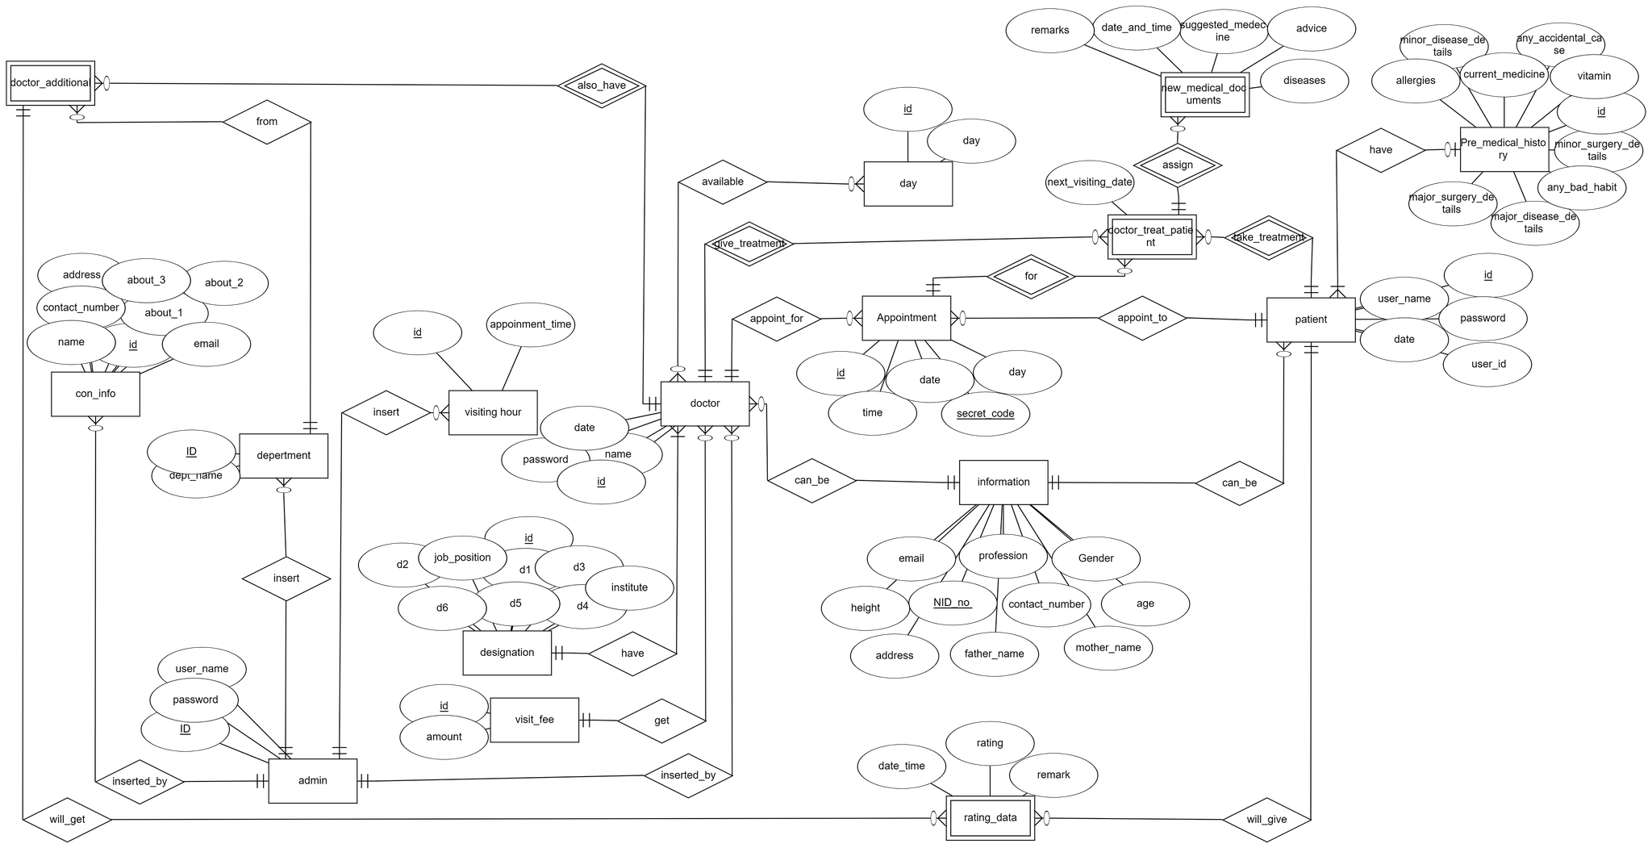
ER Diagram

Slide 9
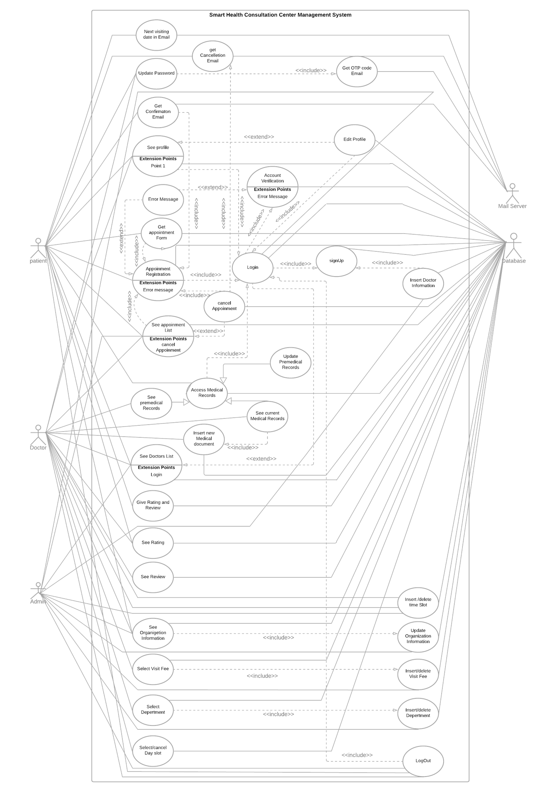
Use Case Diagram

Slide 10
Use case description 1
USE Case #6 | Appointment Registration
Goal in Context | This use case allows users to get an appointment for taking a consultation slot from a doctor.
Precondition | Users have to login their profile and they have to see doctor’s information from where they can make an appointment.
Success End Condition | User will take an appointment from the website
Failed End Condition | Users can’t take appointments.
Primary Actor | Patient
Secondary Actor | database
Trigger | When users press the confirm button after entering their required date, day and slot for a particular doctor.
Description | Step | Action
 | 1 | Choose a doctor and press take appointment button
 | 2 | give required date, day, time which will be preferable for user to take an appointment
 | 3 | Press confirm button
 | 4 | Verify whether given information is matched with that doctor’s day and date from the database or not.
 | 5 | Check validation of date
 | 6 | If it is matched then verify the preferable time slot is taken or not.
 | 7 | If given information matches with the required doctor’s date, day, time slot appointment will successfully generate.
 | 8 | Appointment information will be stored in the database.
Extension or Variations | Step | Branching Action
 | 1. | Error message will be shown.

Slide 11
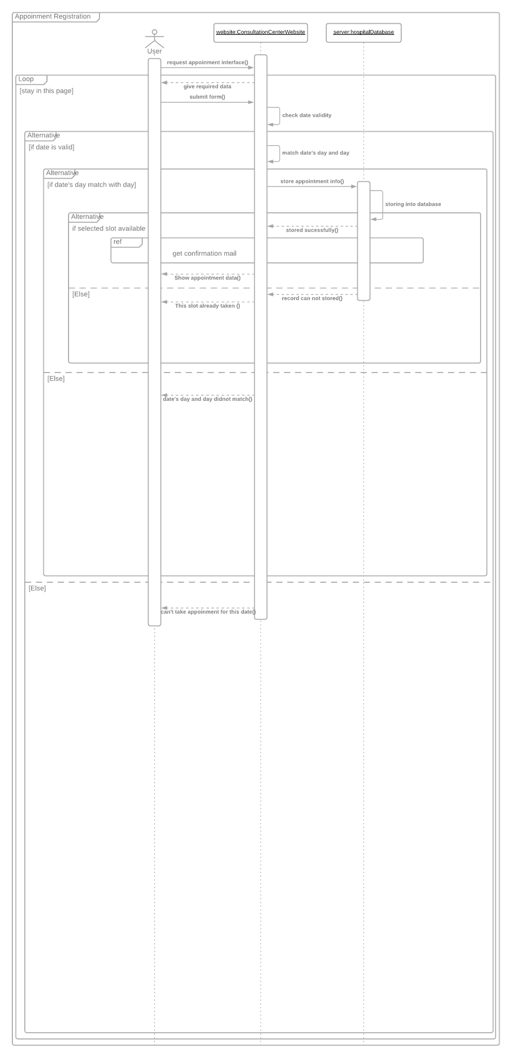
Sequence Diagram 1

Slide 12
Use Case description 2
USE Case #13 | Insert new medical documents
Goal in Context | This use case allows doctors to insert prescribed medical records in their patient’s profile
Precondition | patients have to take treatment before updating their current medical records by doctors.
Success End Condition | doctors will insert prescribed medical records in their patient’s profile.
Failed End Condition | Doctors cannot give prescribed medical records in their patient’s profile.
Primary Actor | doctor
Secondary Actor | database
Trigger | When a doctor presses the submit button by inserting their patient’s medical records in that patient’s profile.
Description | Step | Action
 | 1 | Press insert new medical documents button
 | 2 | Insert a secret code for accessing their patient’s medical records.
 | 3 | Verification of that secret code in the database server.
 | 4 | Website give a form to fill up
 | 5 | Insert required information about medical history.
 | 6 | Check if inserting medical documents has already been done or not.
 | 7 | If not Store them in the database by pressing the submit button.
Extension or Variations | Step | Branching Action

Slide 13
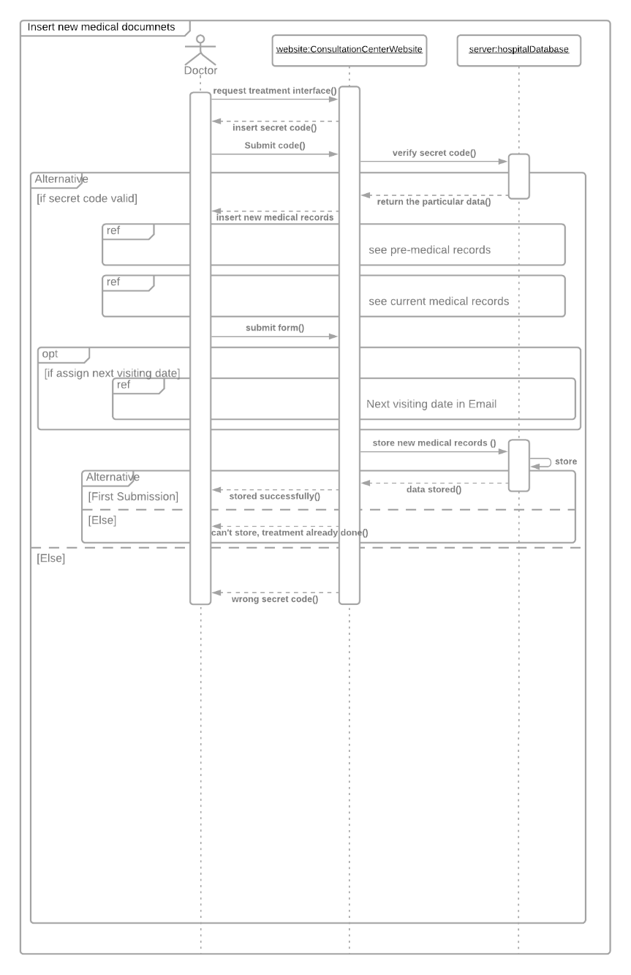
Sequence Diagram 2:

Slide 14
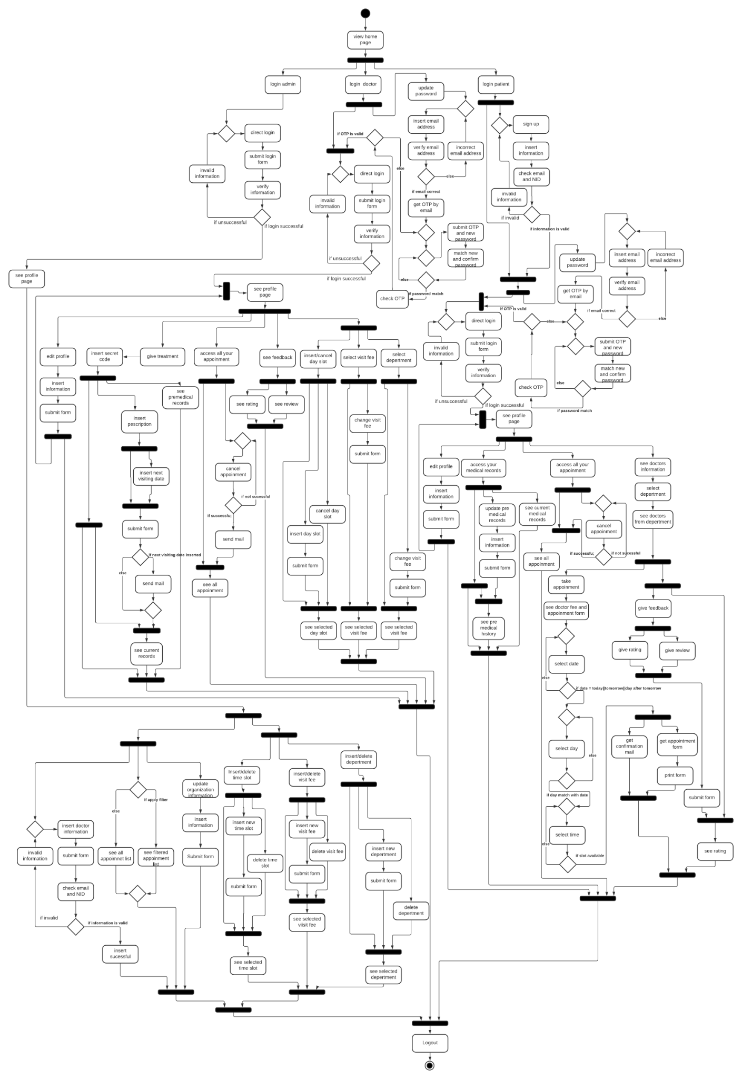
Activity Diagram:

Slide 15
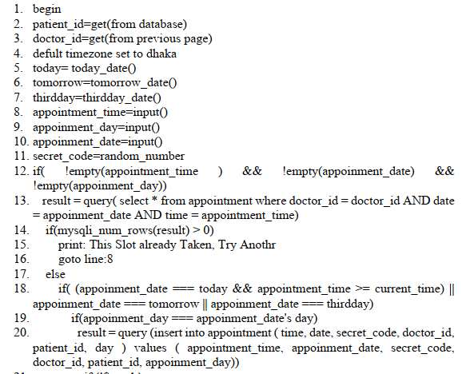
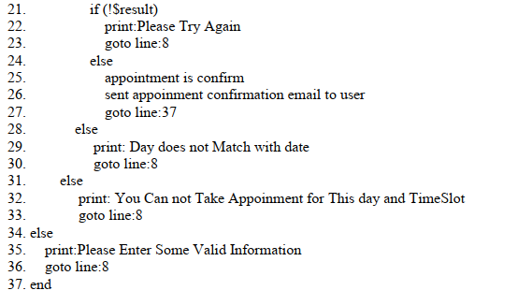
White Box Testing: Take appointment

Slide 16
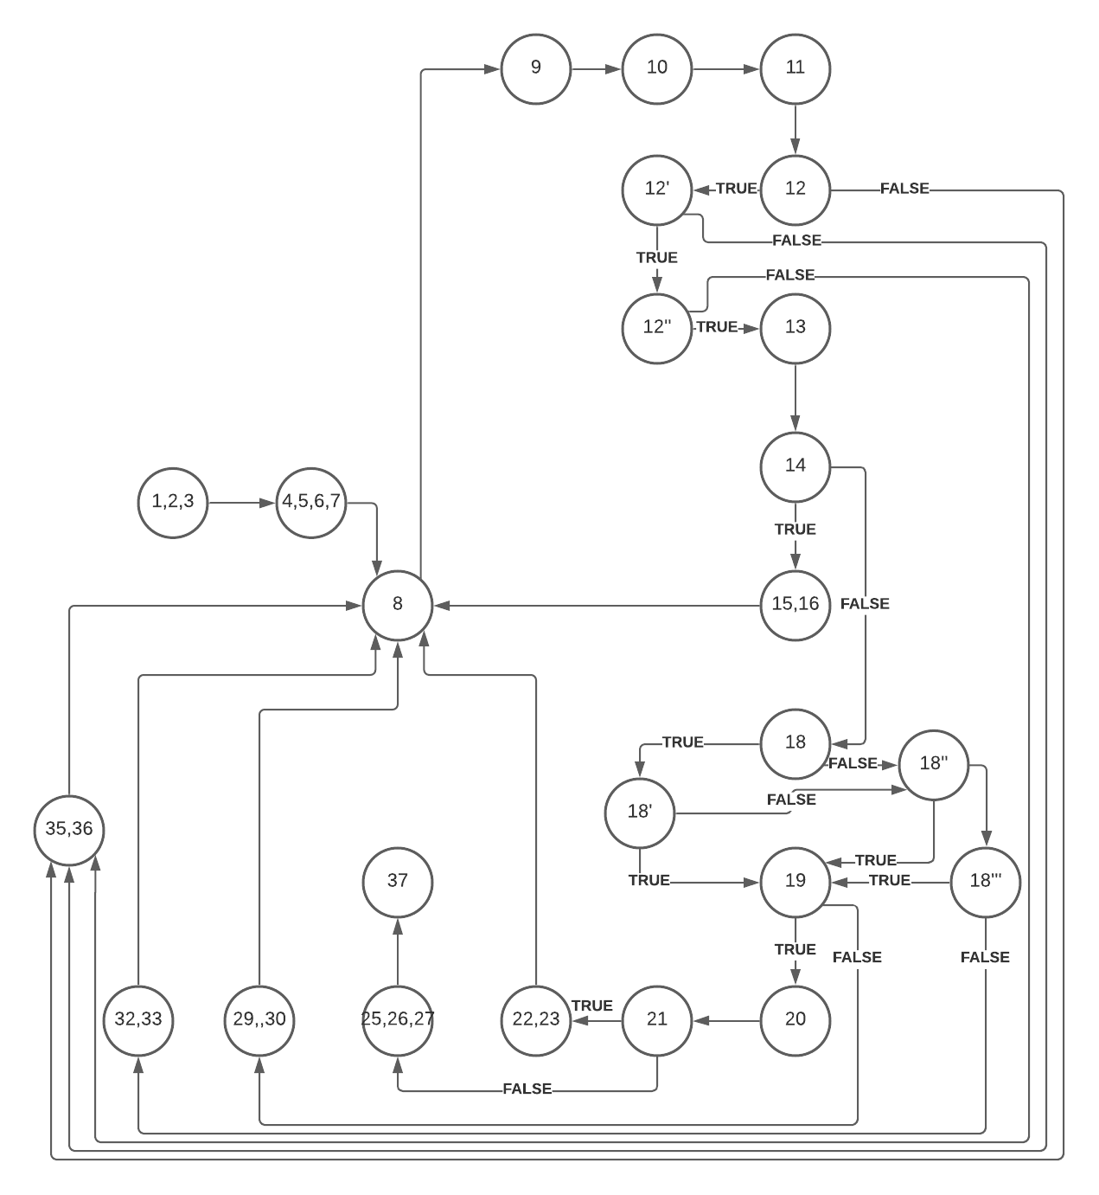
Control Flow Graph:
1. Statement coverage
2. Edge Coverage
3. Path Coverage
4. Condition Coverage

Slide 17
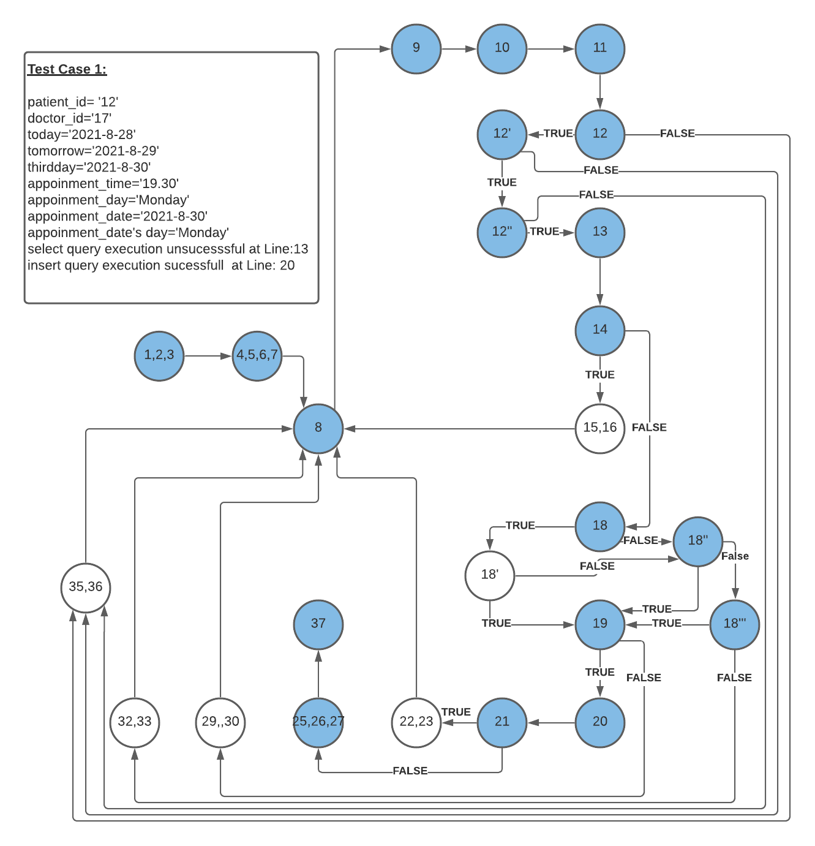
Statement Coverage

Slide 18
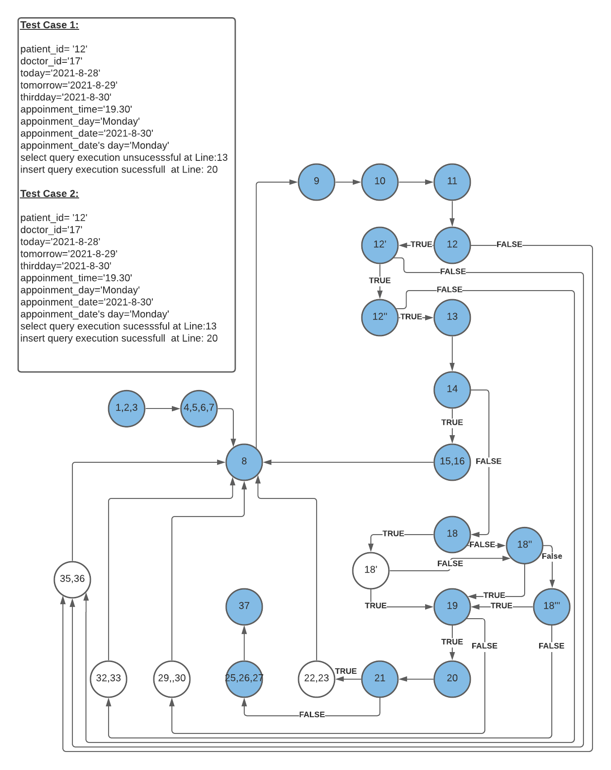
Statement Coverage

Slide 19
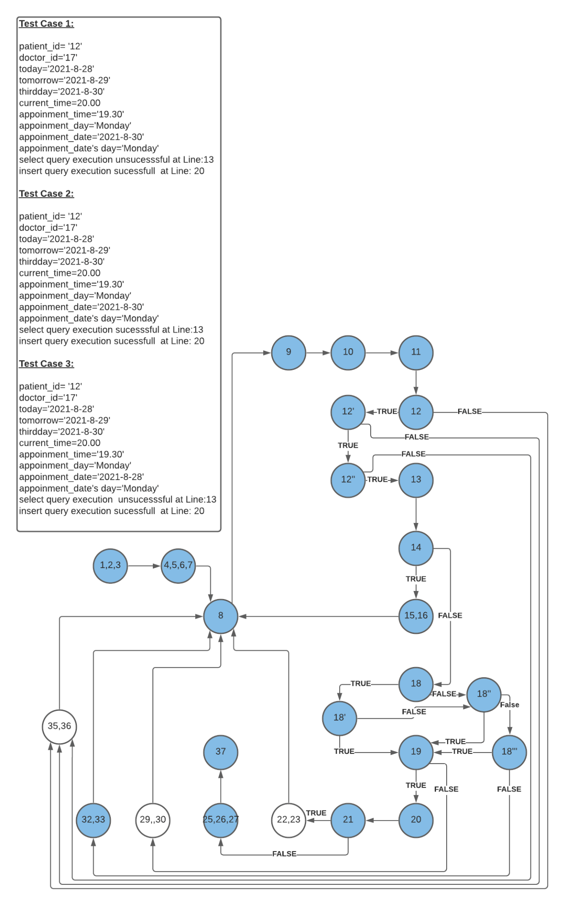
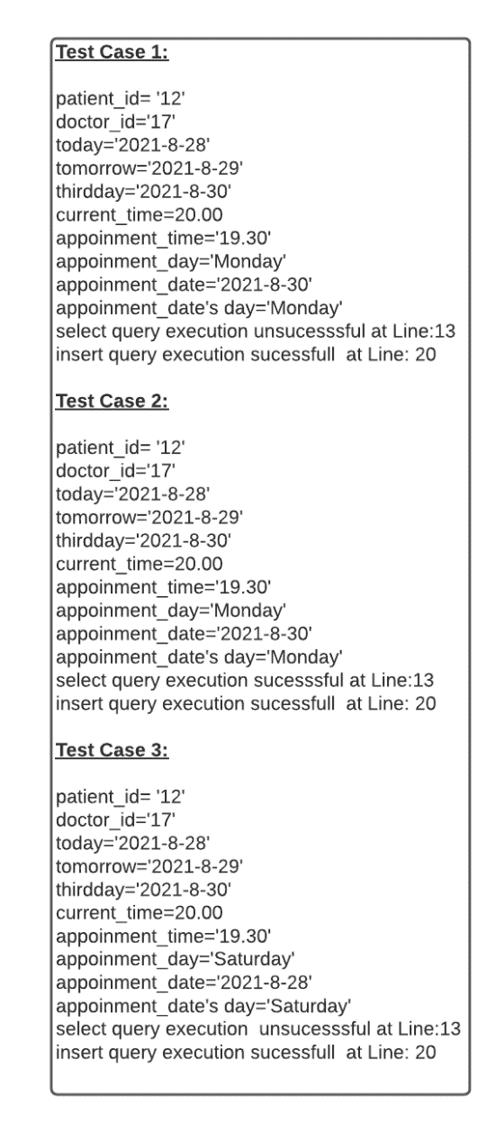
Statement Coverage

Slide 20
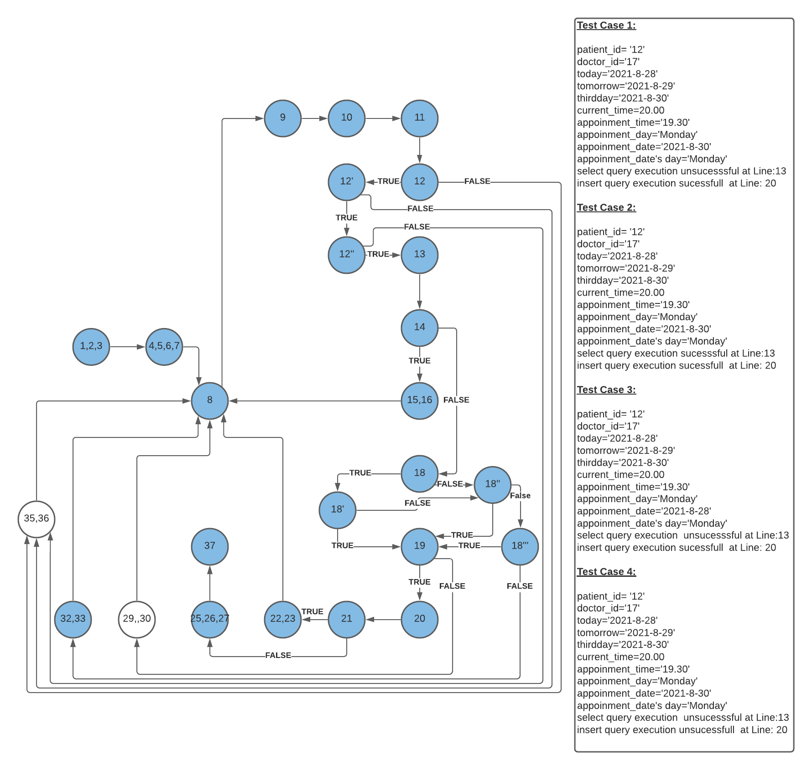
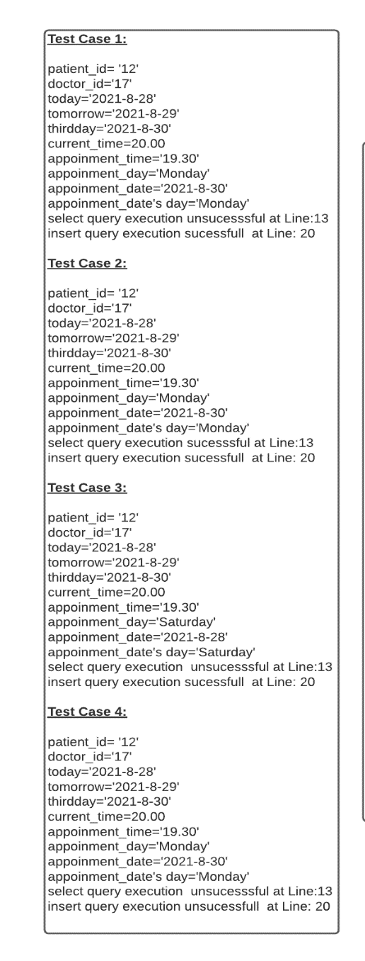
Statement Coverage

Slide 21
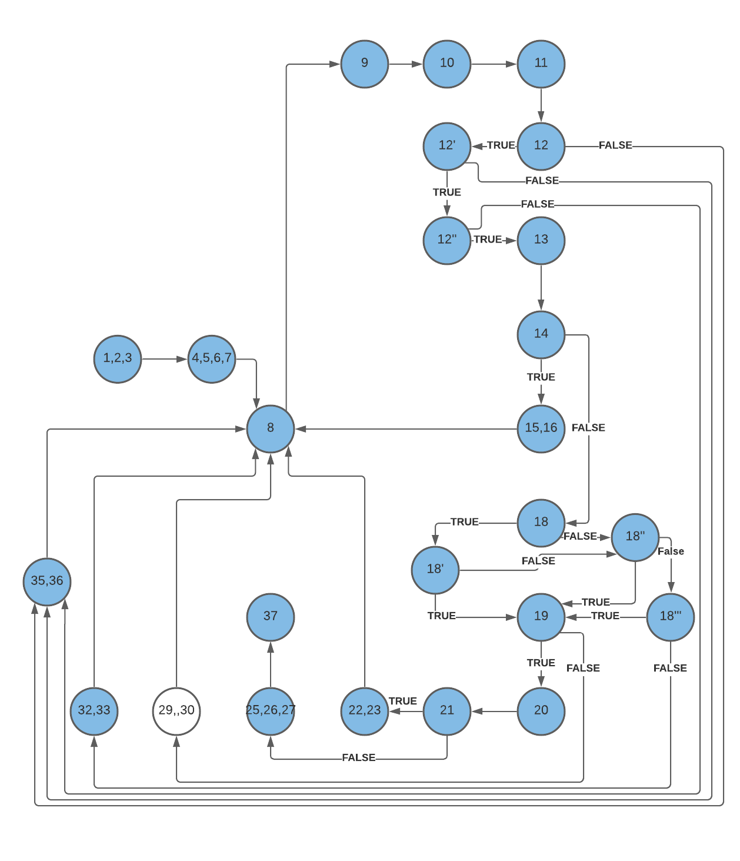
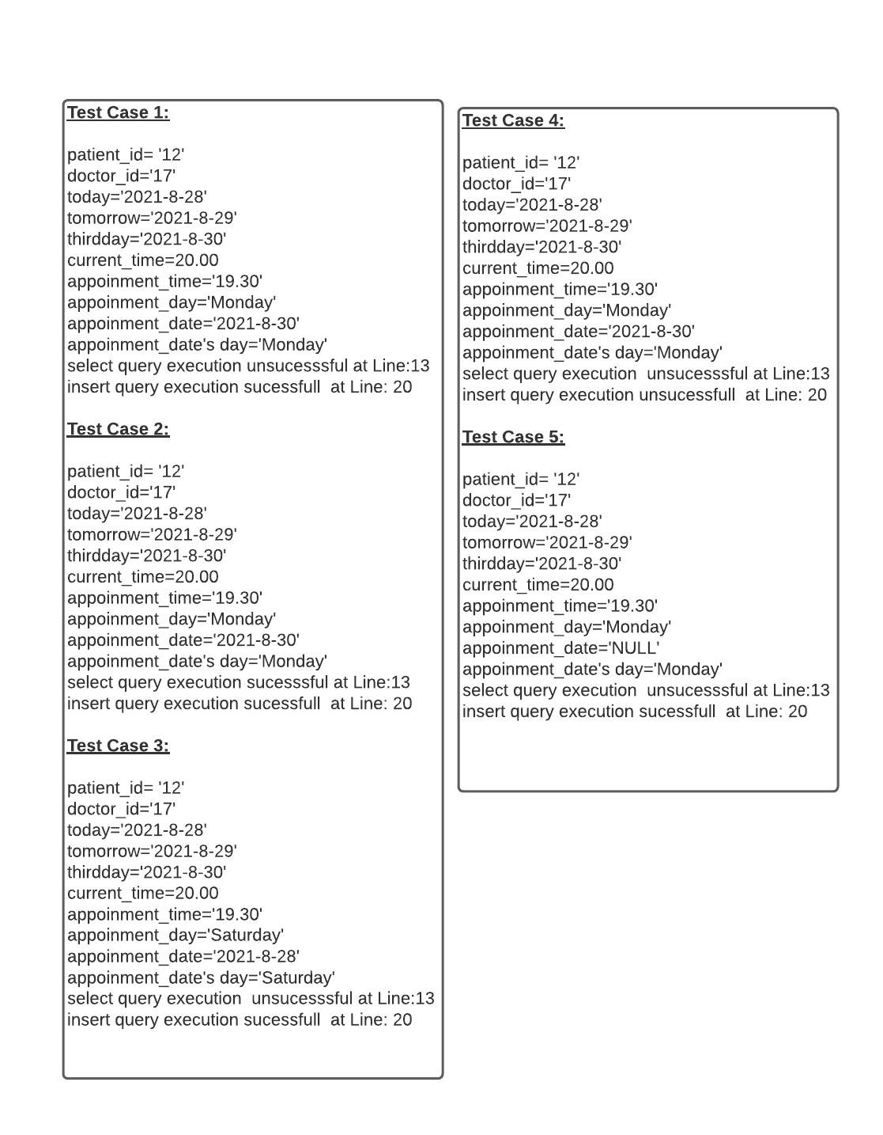
Statement Coverage

Slide 22
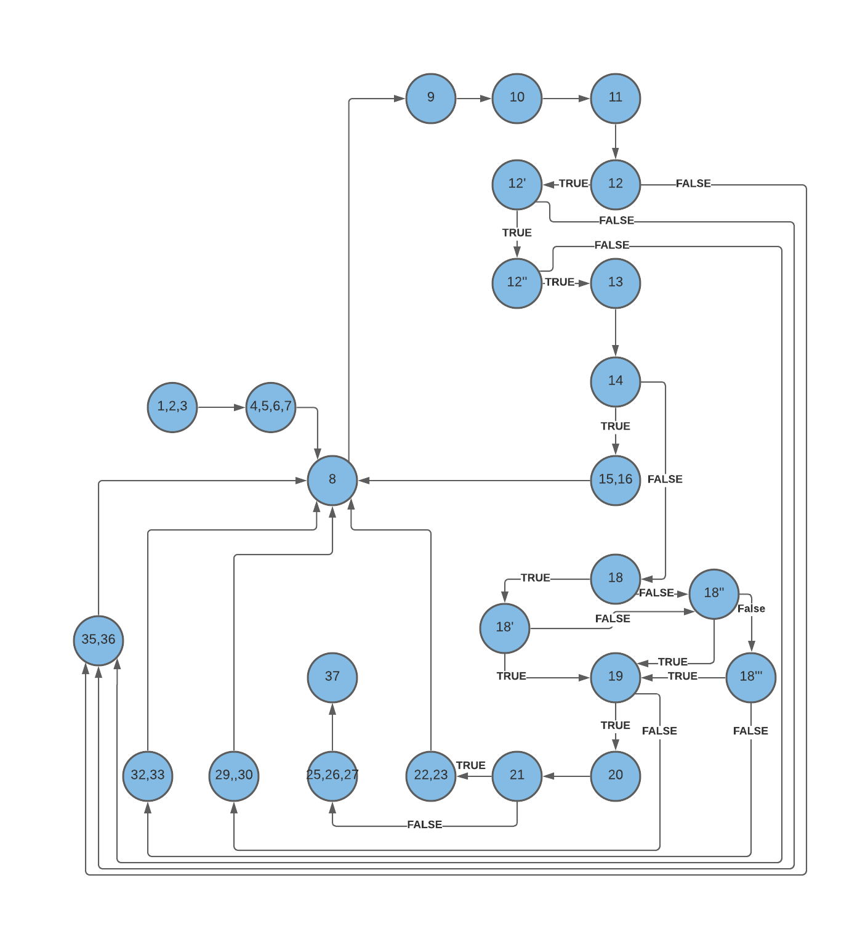
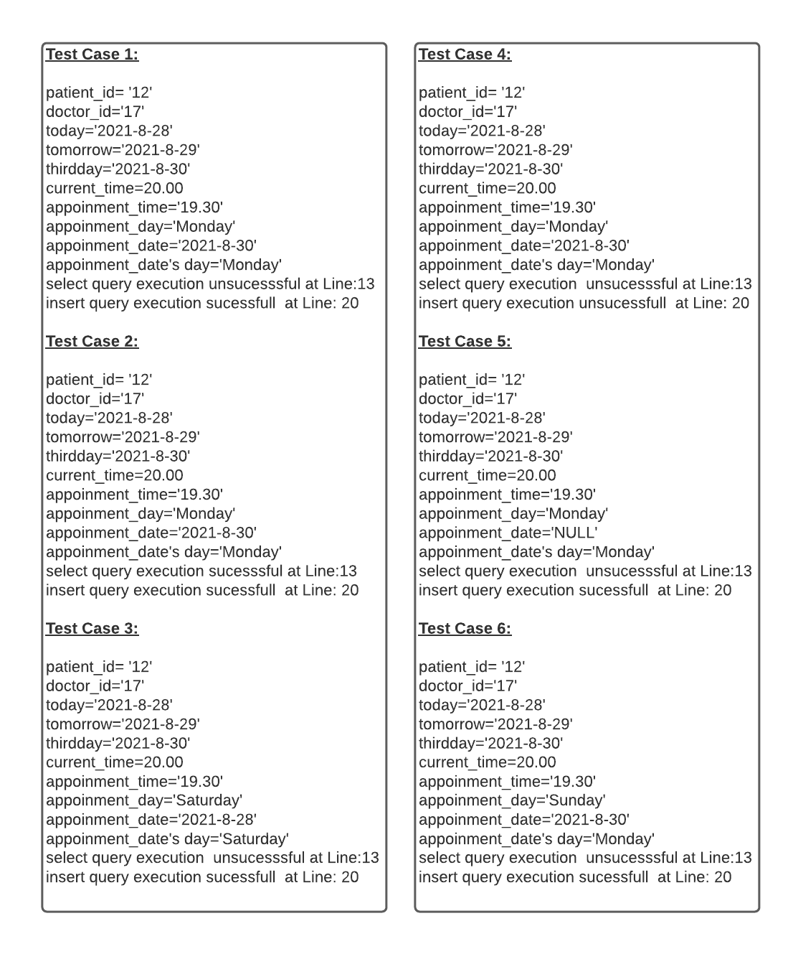
Statement Coverage

Slide 23
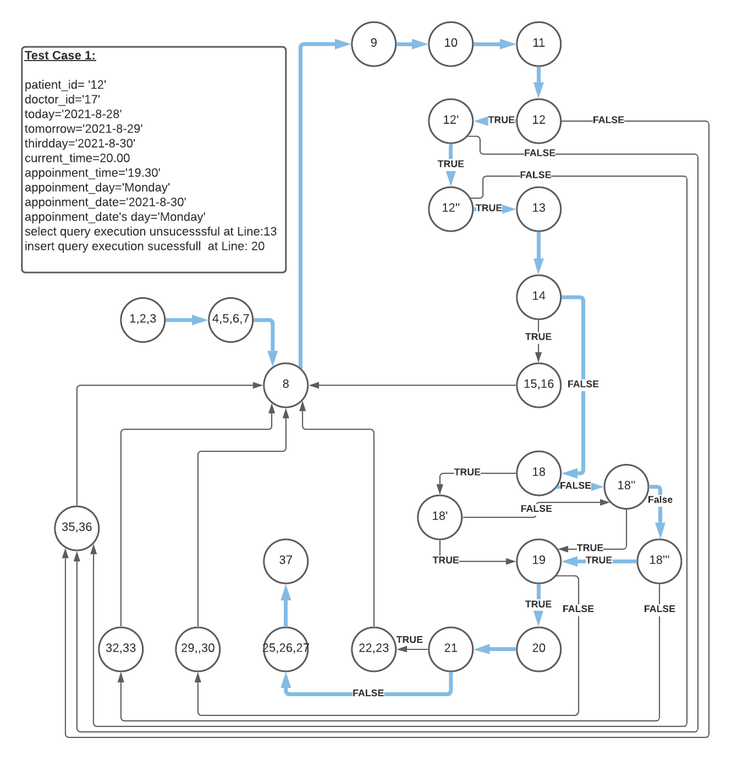
Edge Coverage

Slide 24
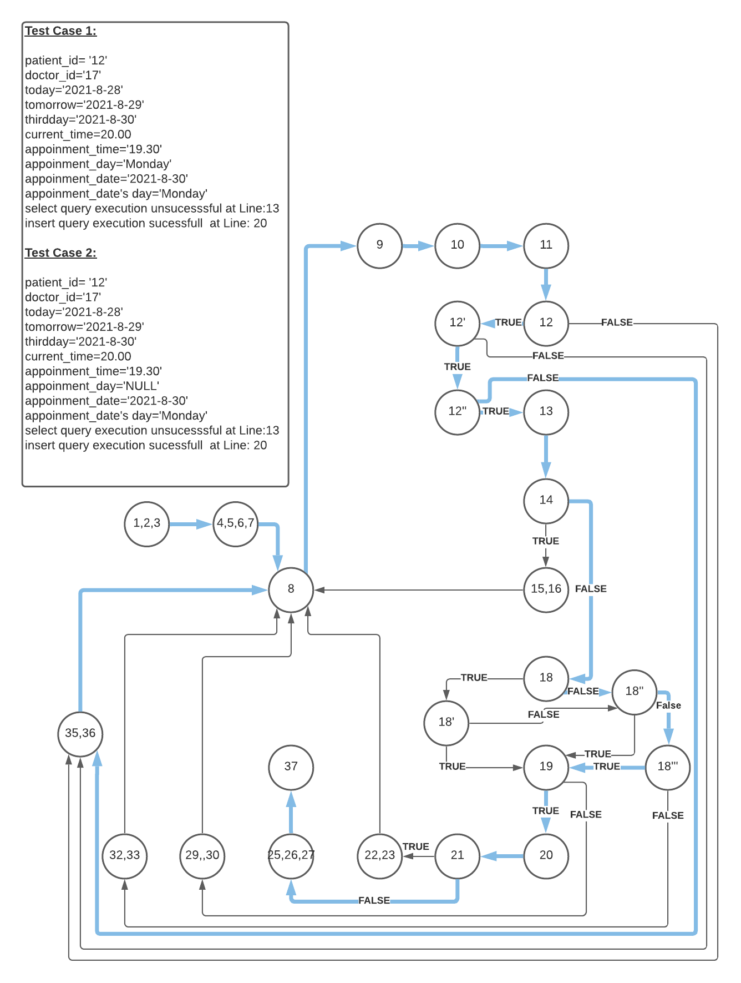
Edge Coverage

Slide 25
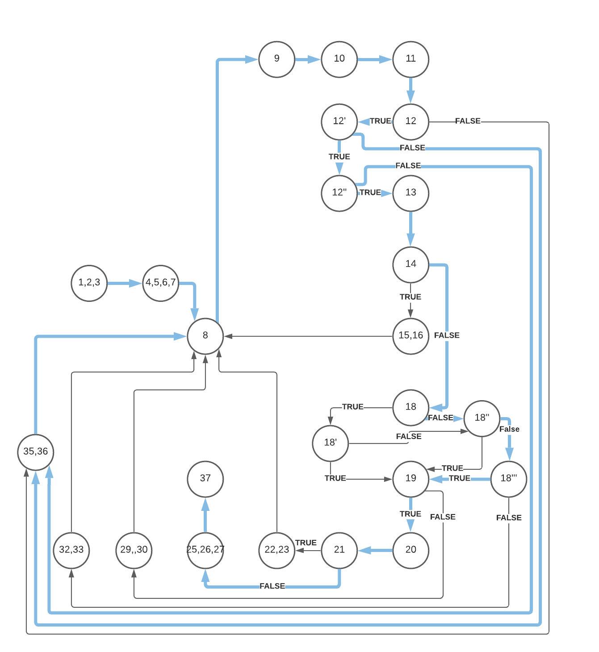
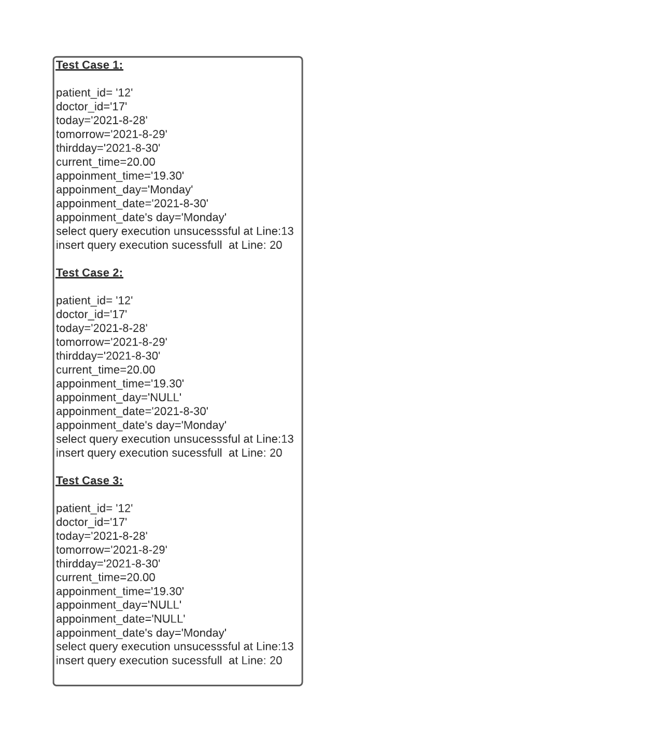
Edge Coverage

Slide 26
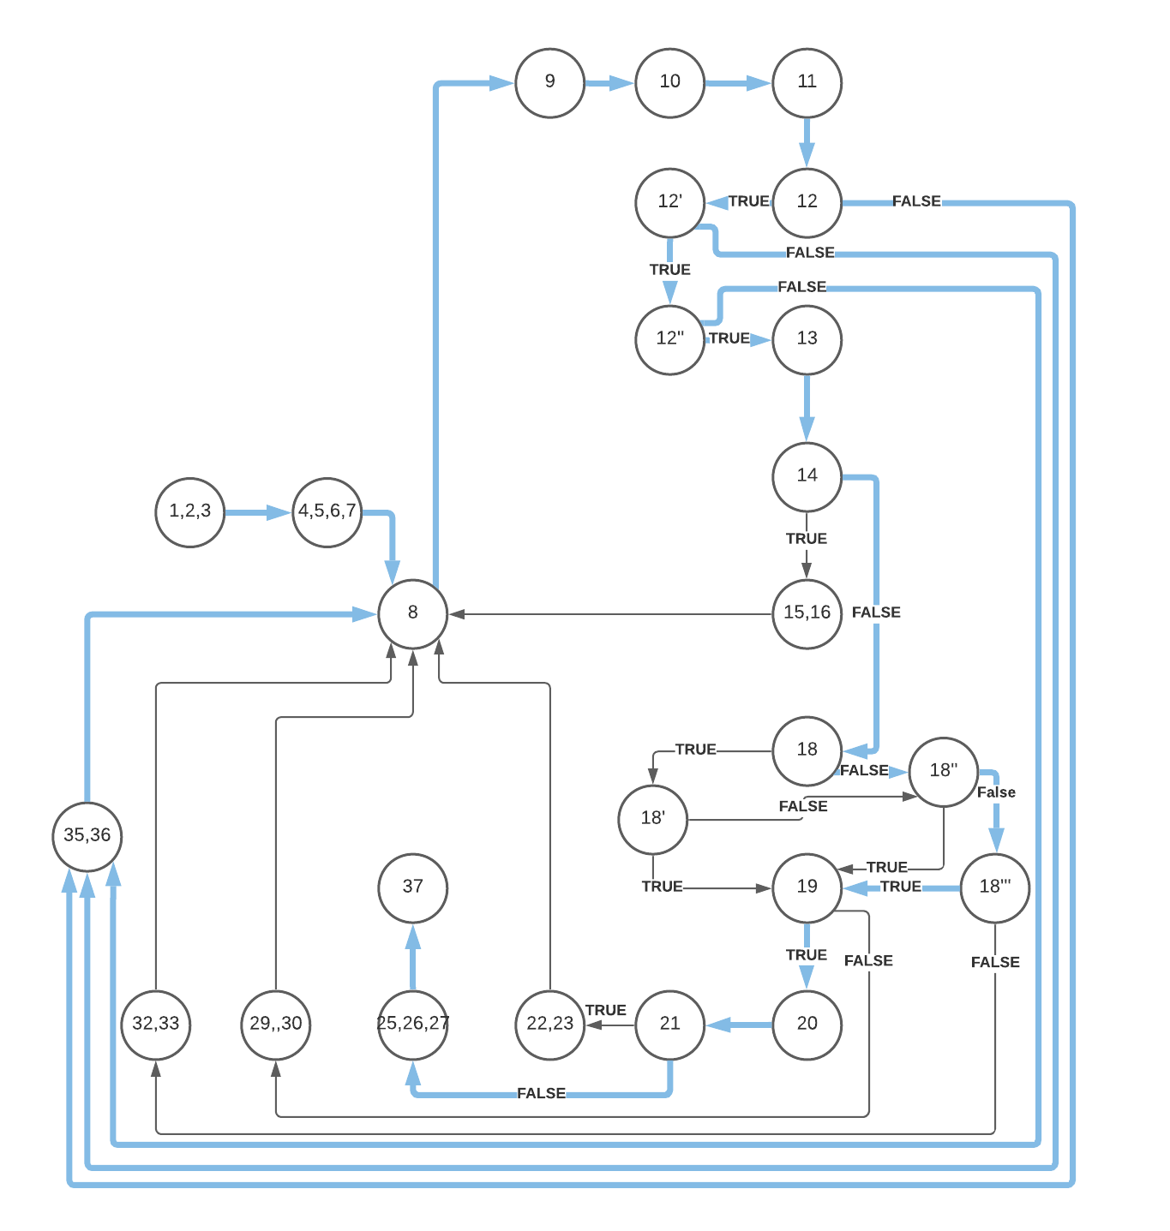
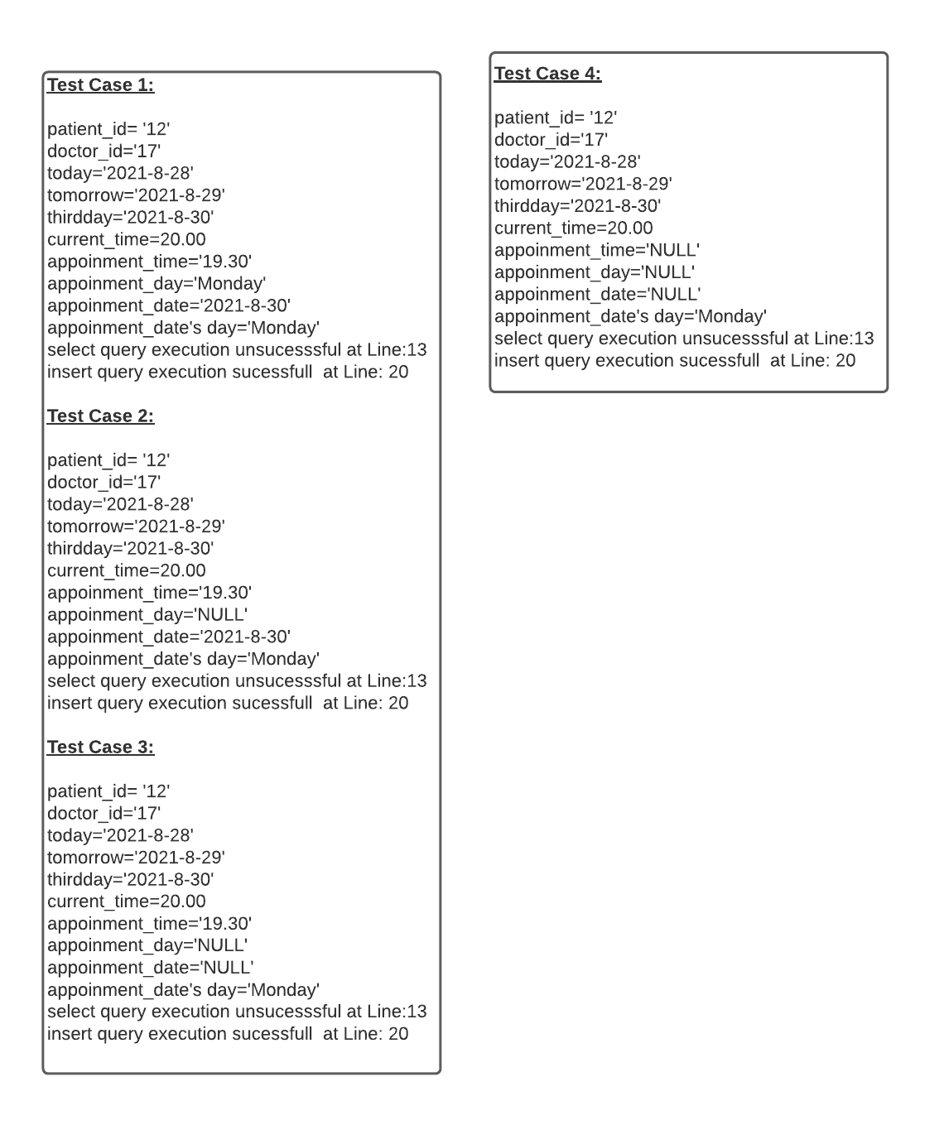
Edge Coverage

Slide 27
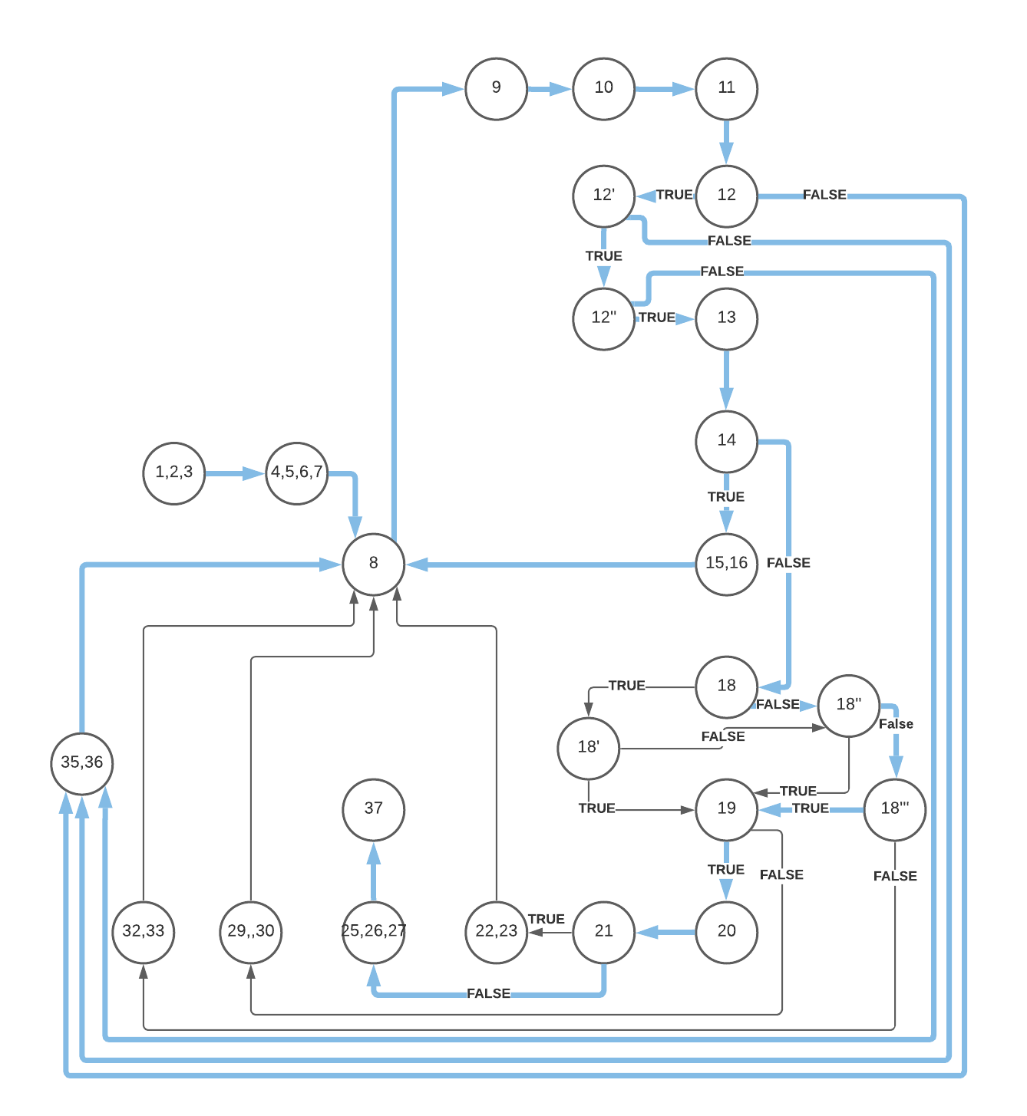
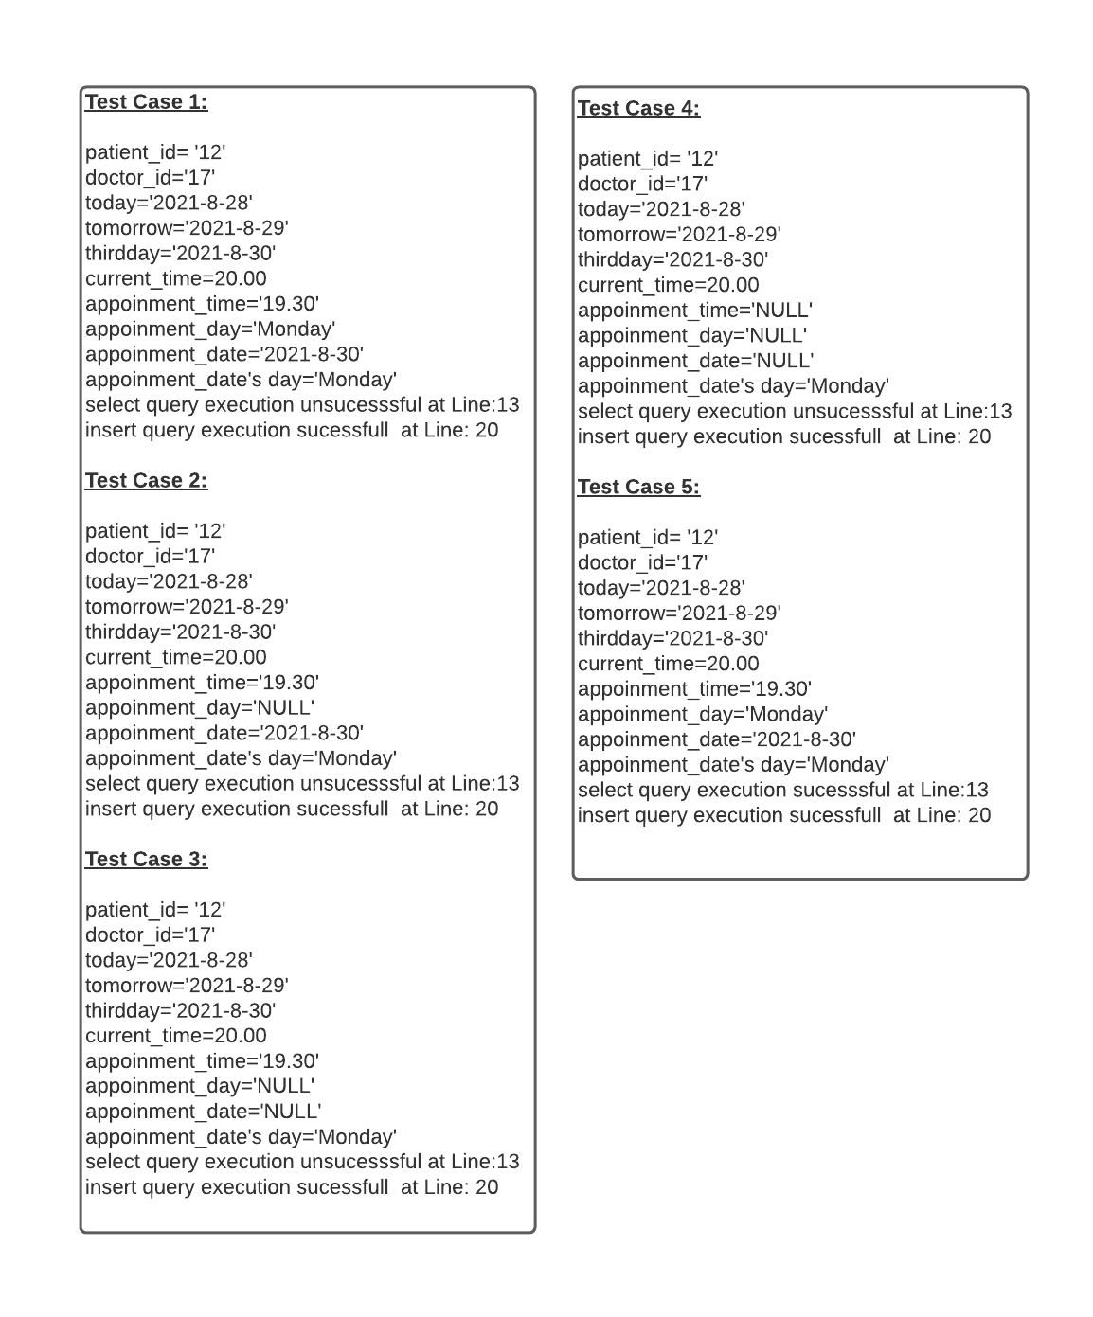
Edge Coverage

Slide 28
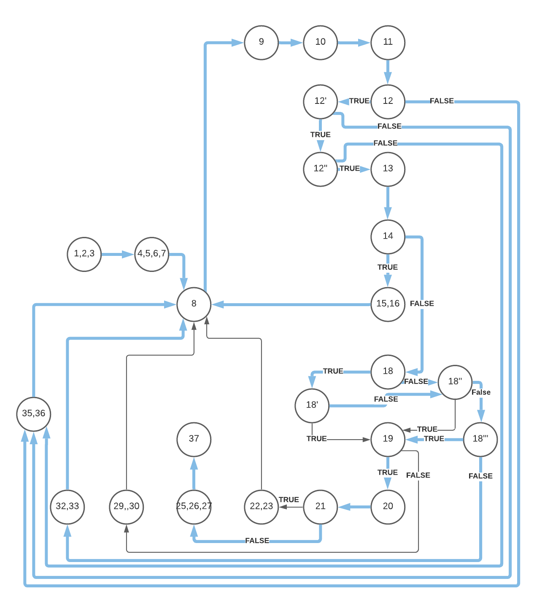
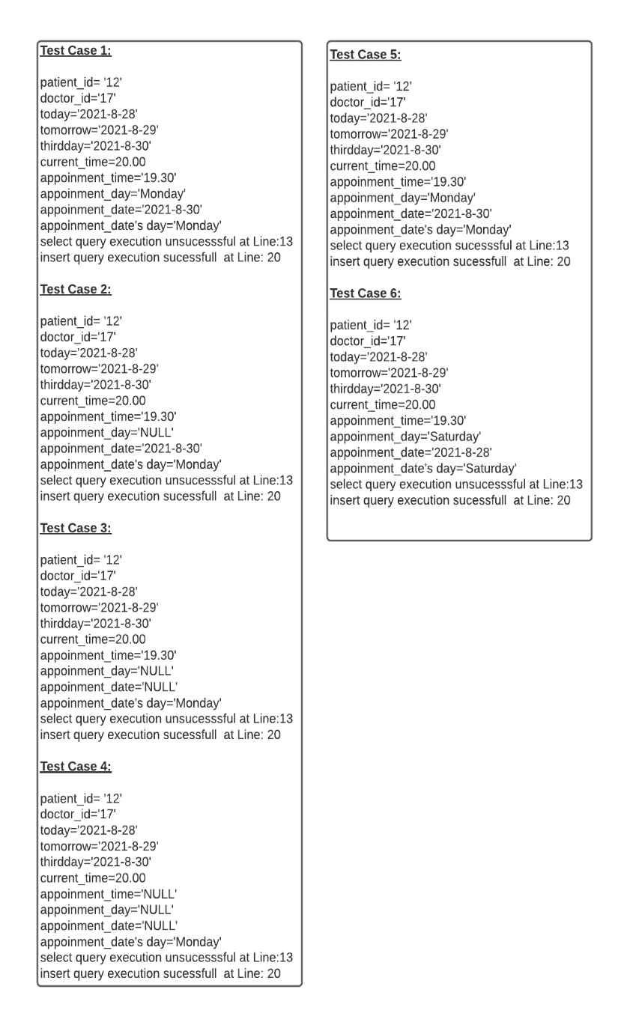
Edge Coverage

Slide 29
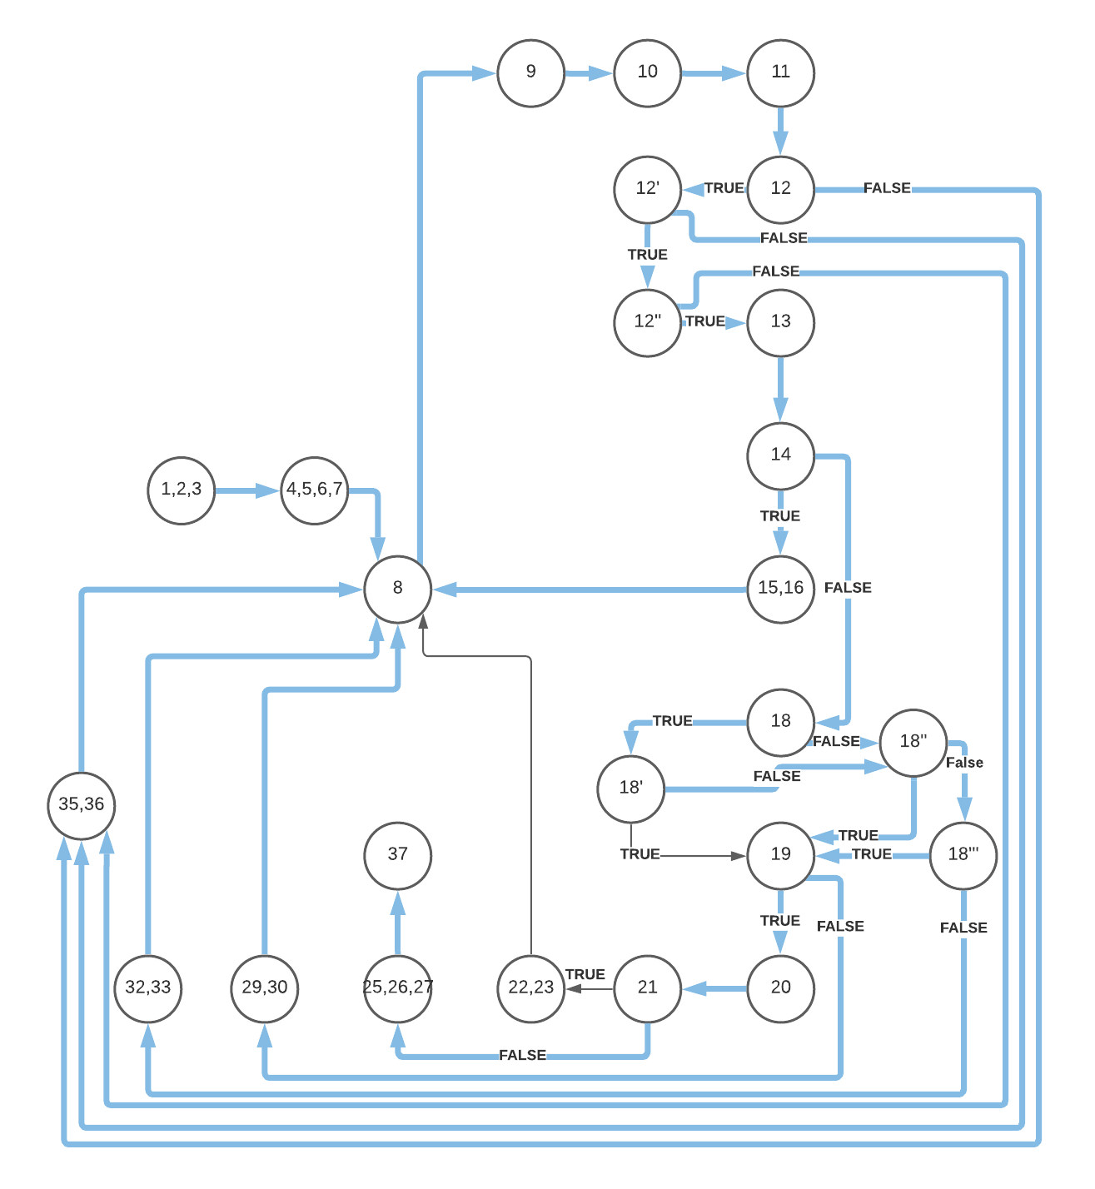
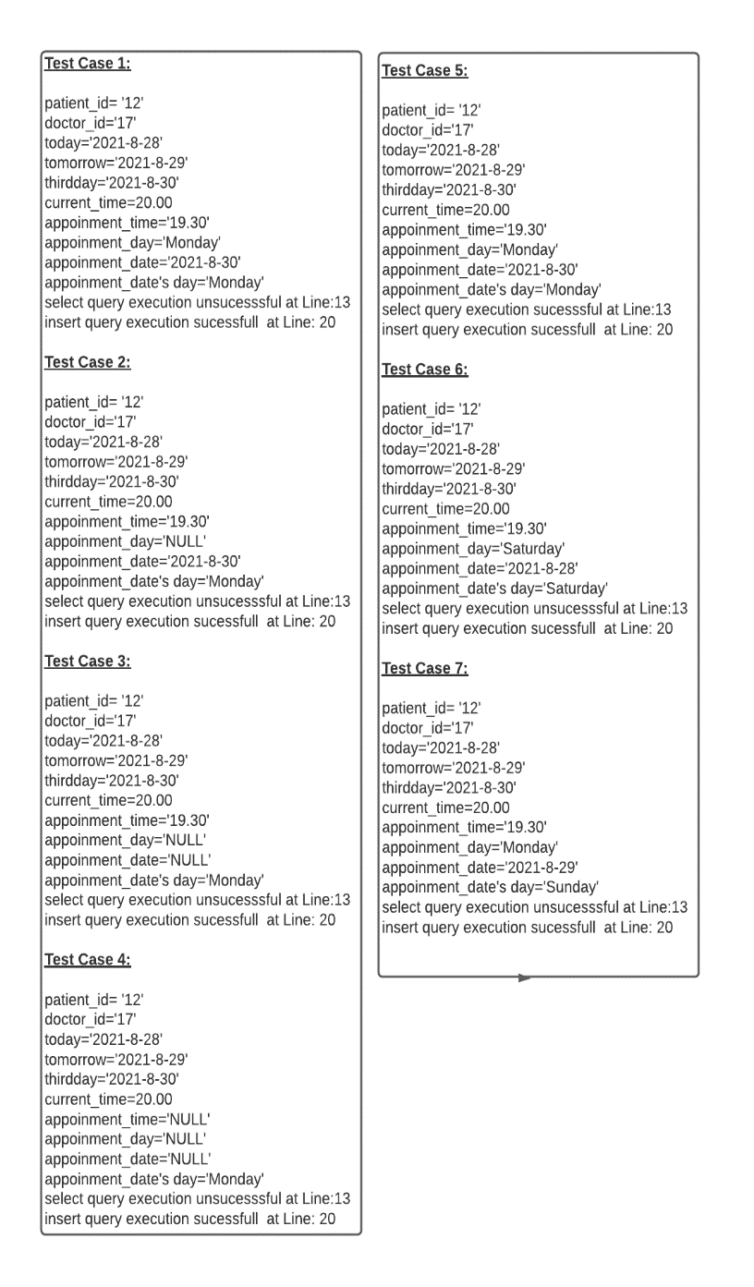
Edge Coverage

Slide 30
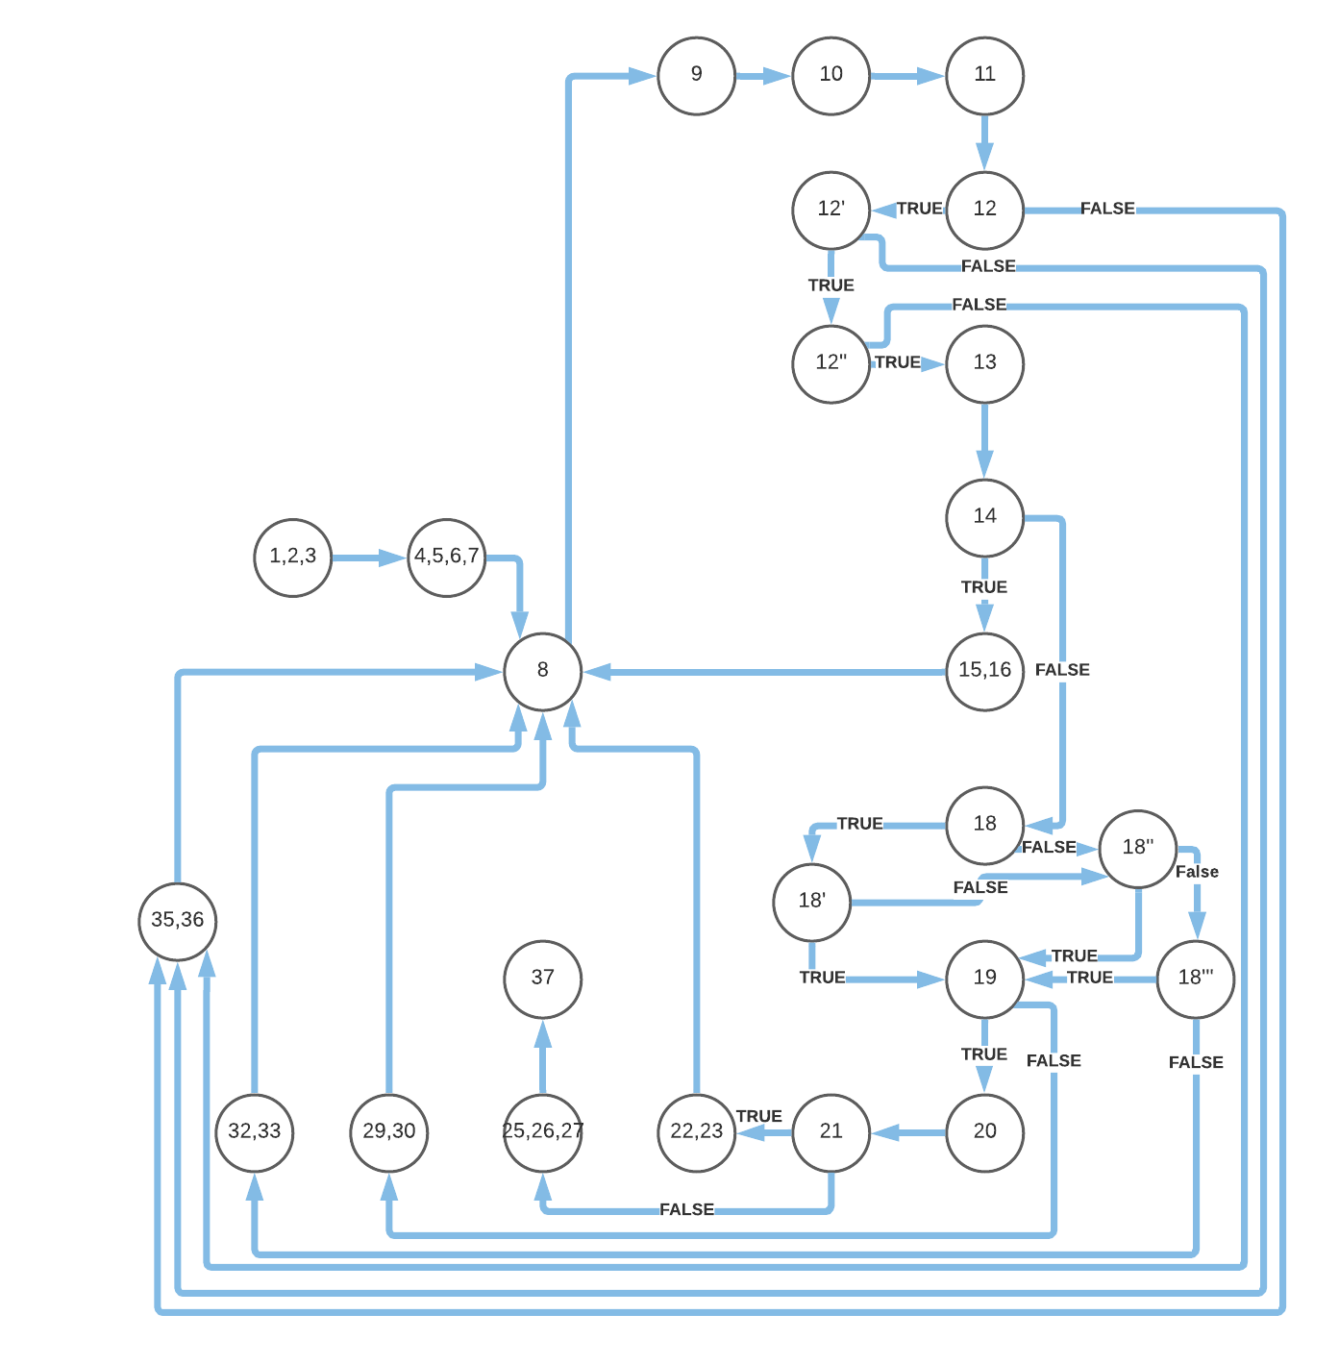
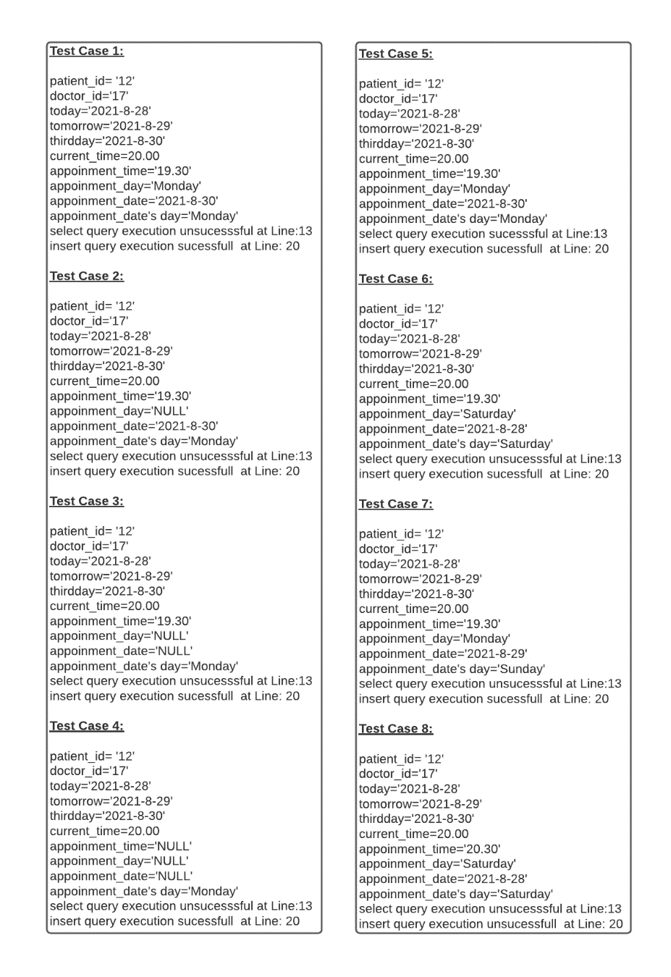
Edge Coverage

Slide 31
path Coverage

Slide 32
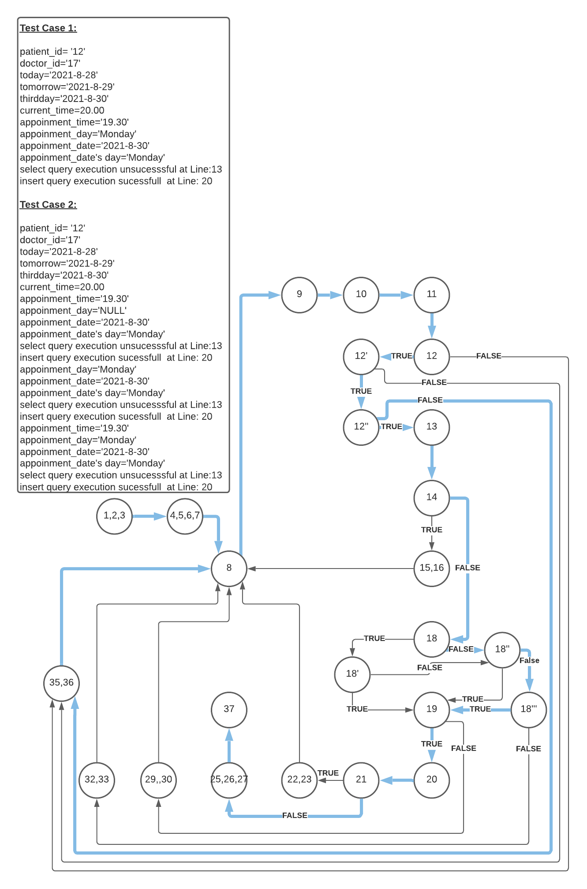
path Coverage

Slide 33
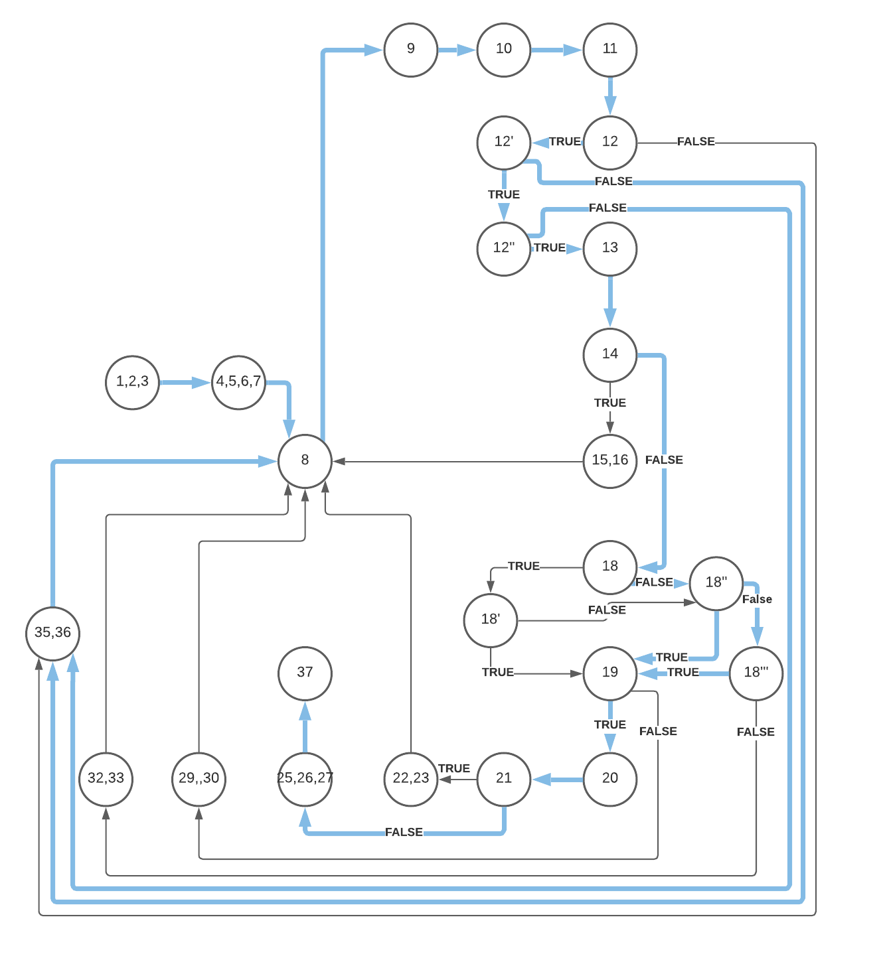
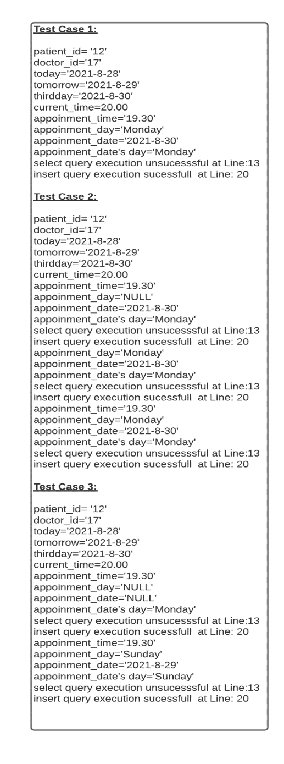
path Coverage

Slide 34
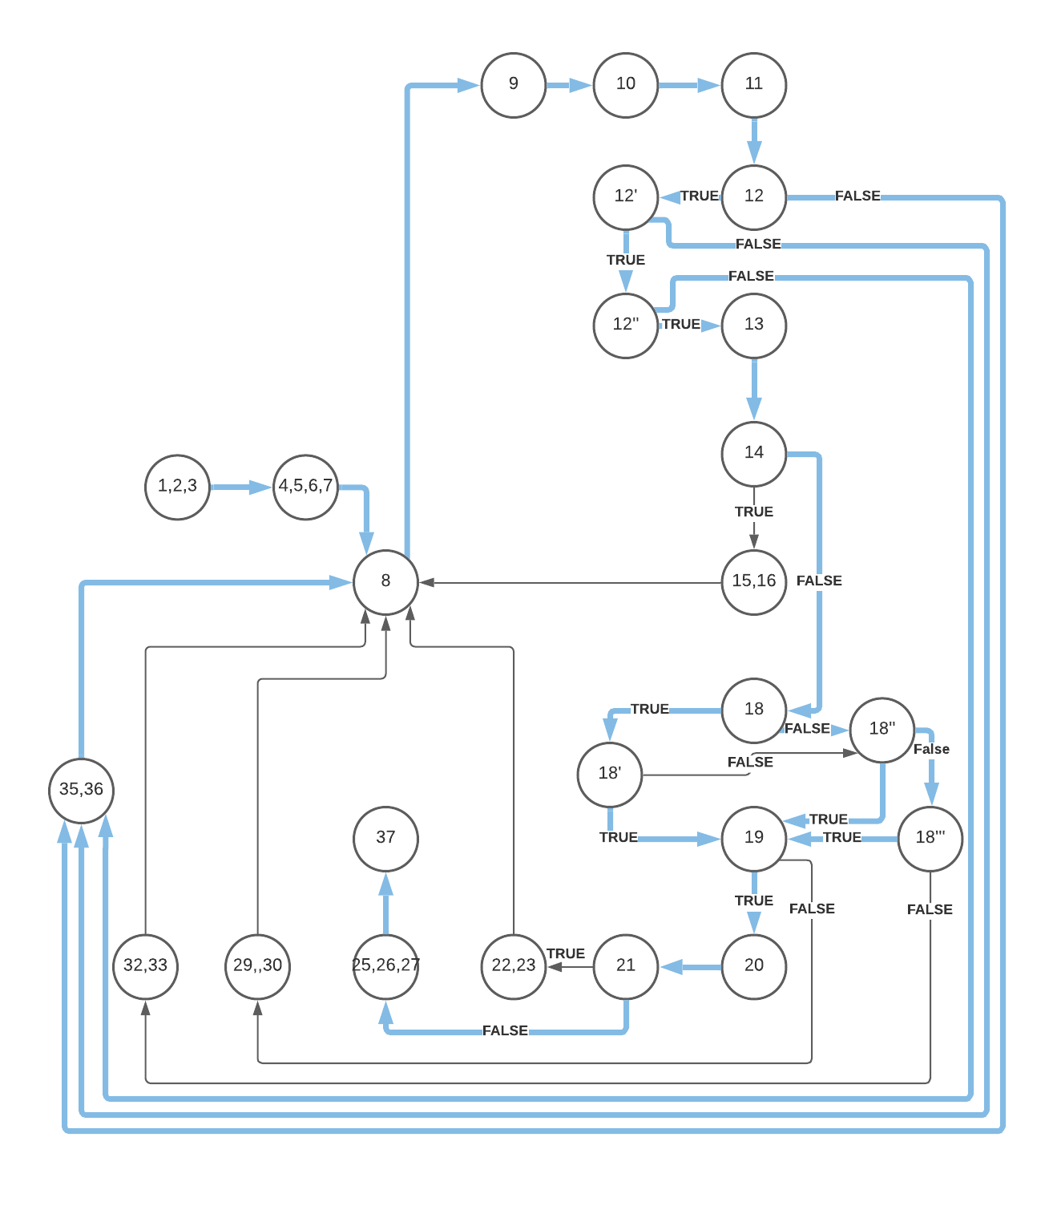
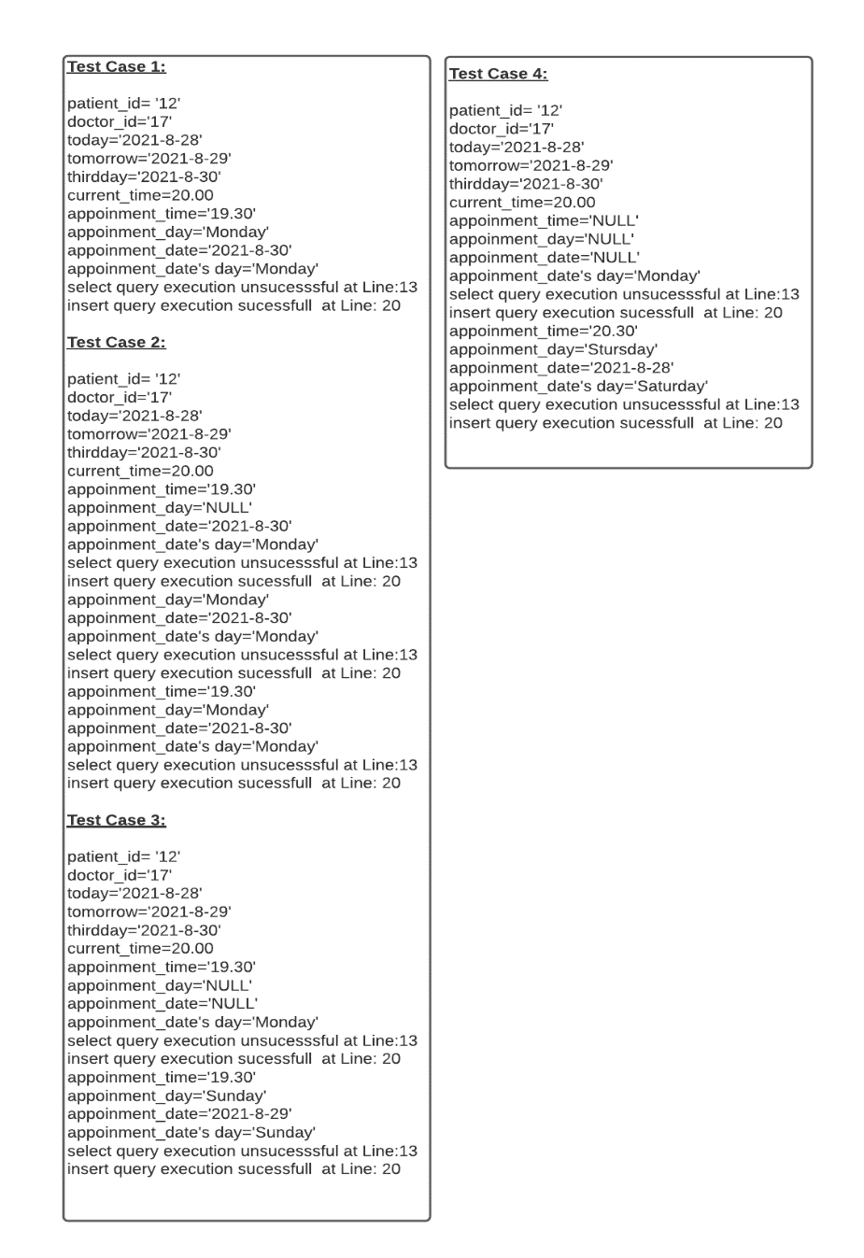
path Coverage

Slide 35
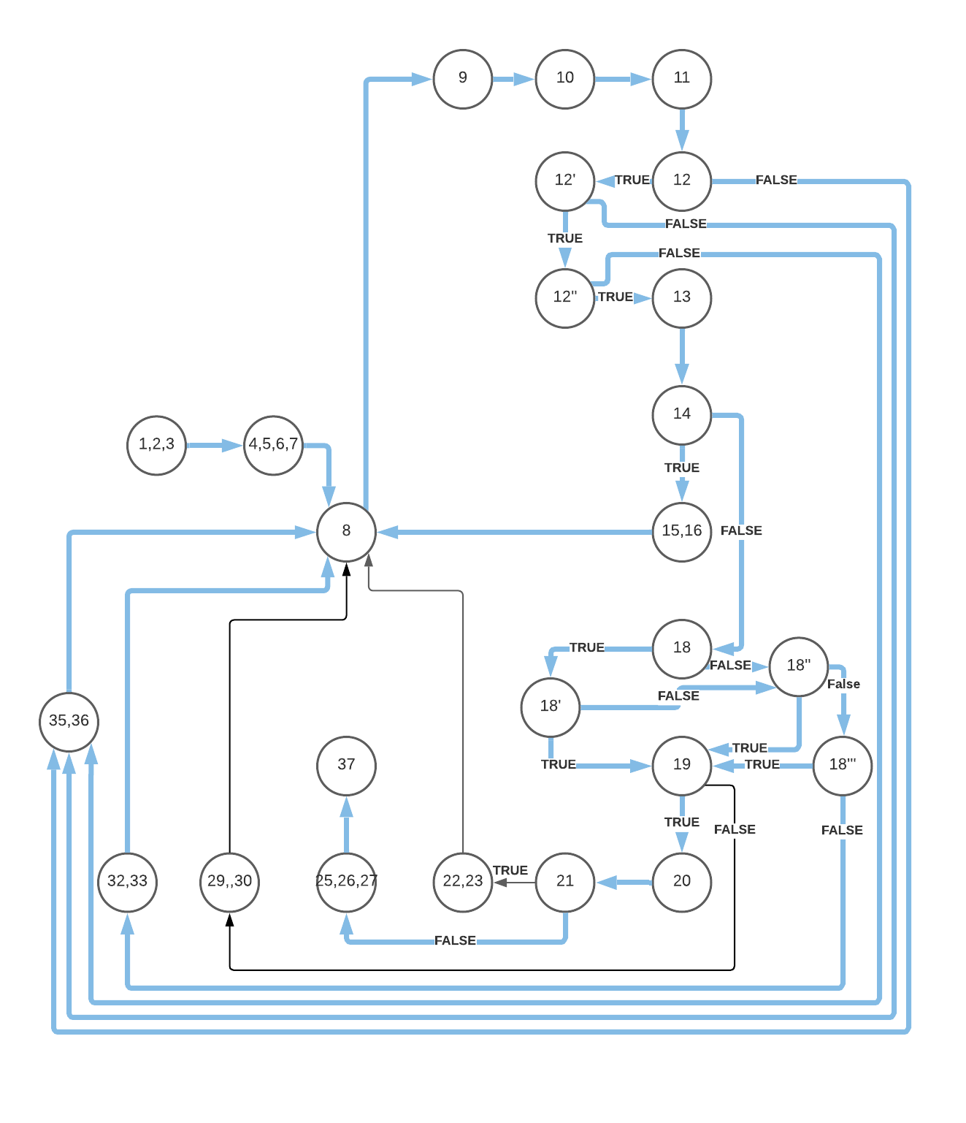
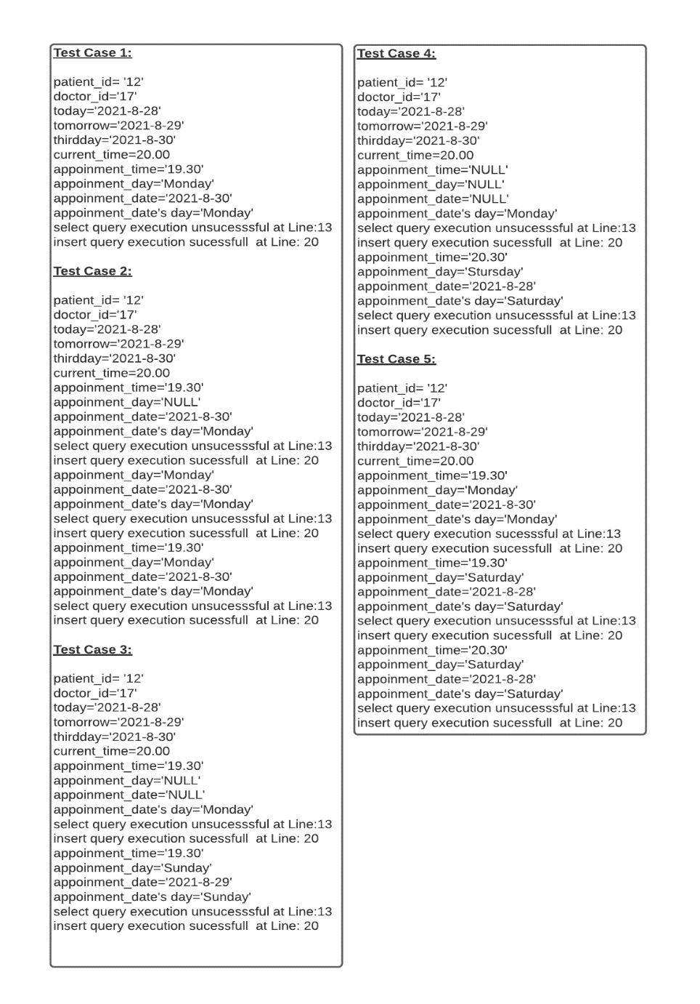
path Coverage

Slide 36
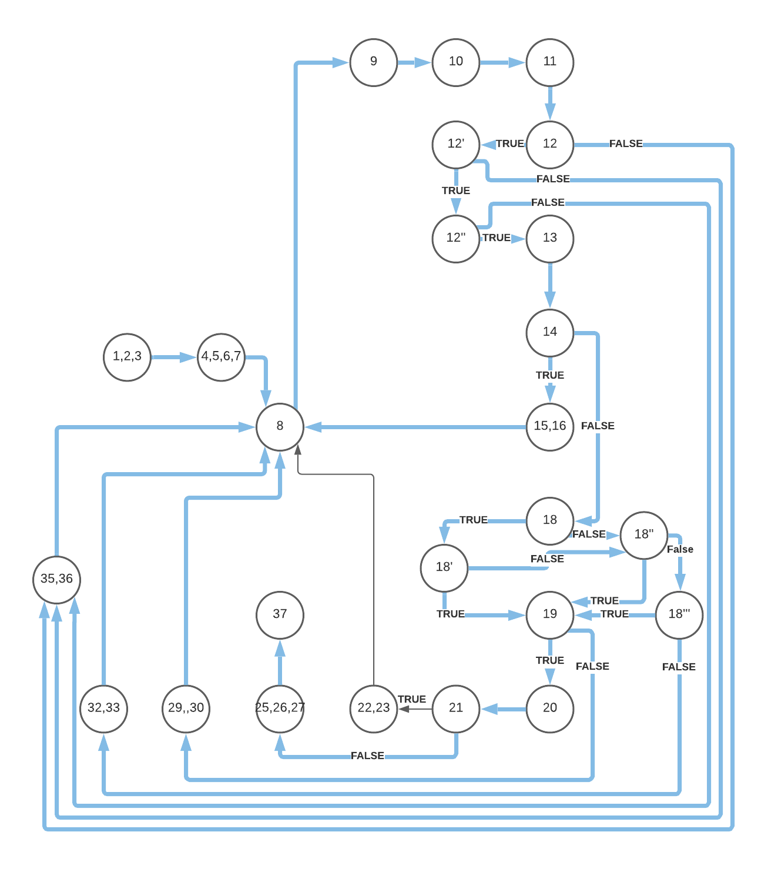
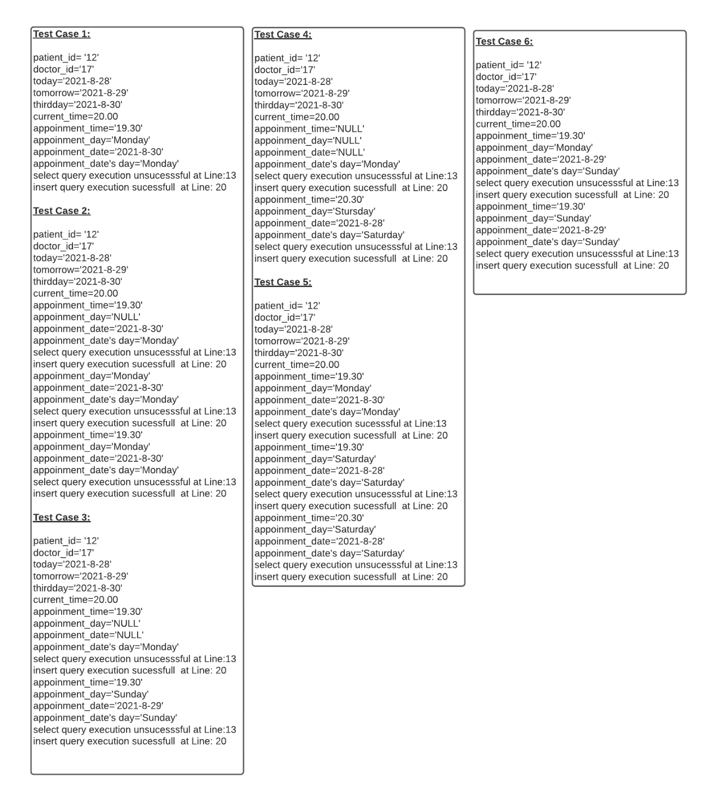
path Coverage

Slide 37
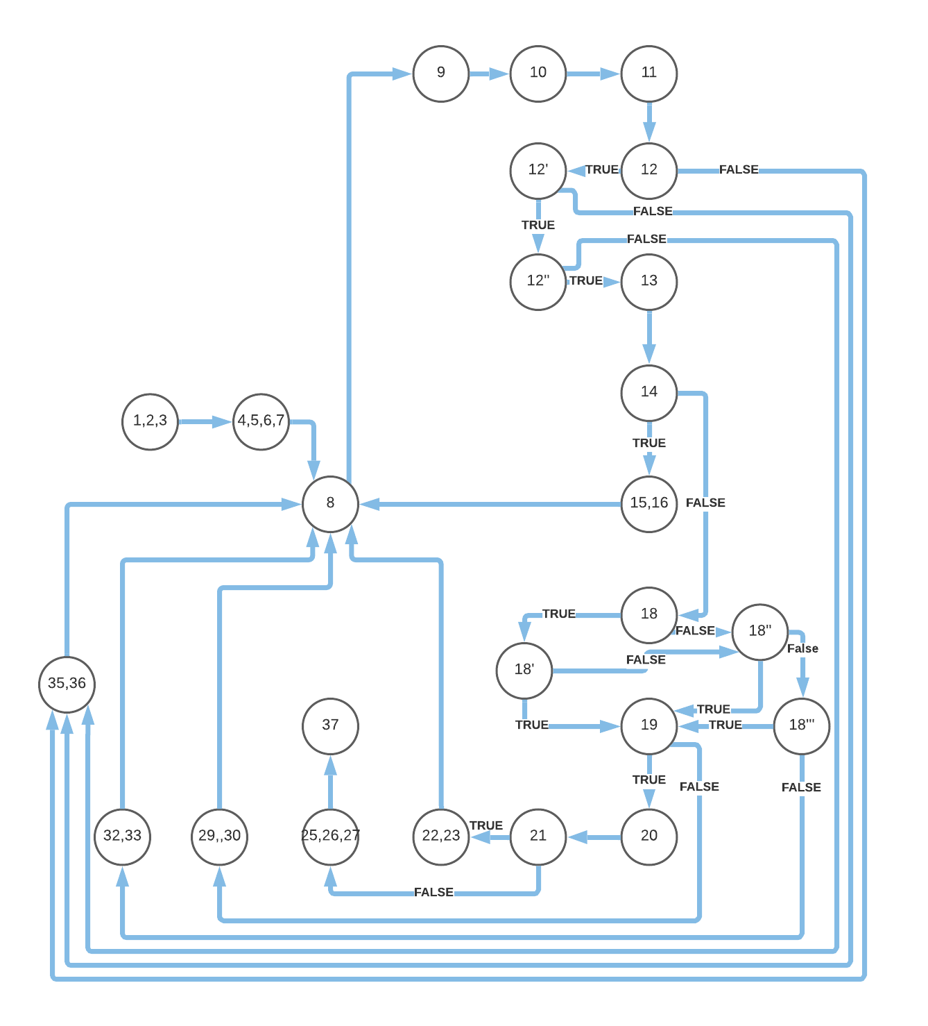
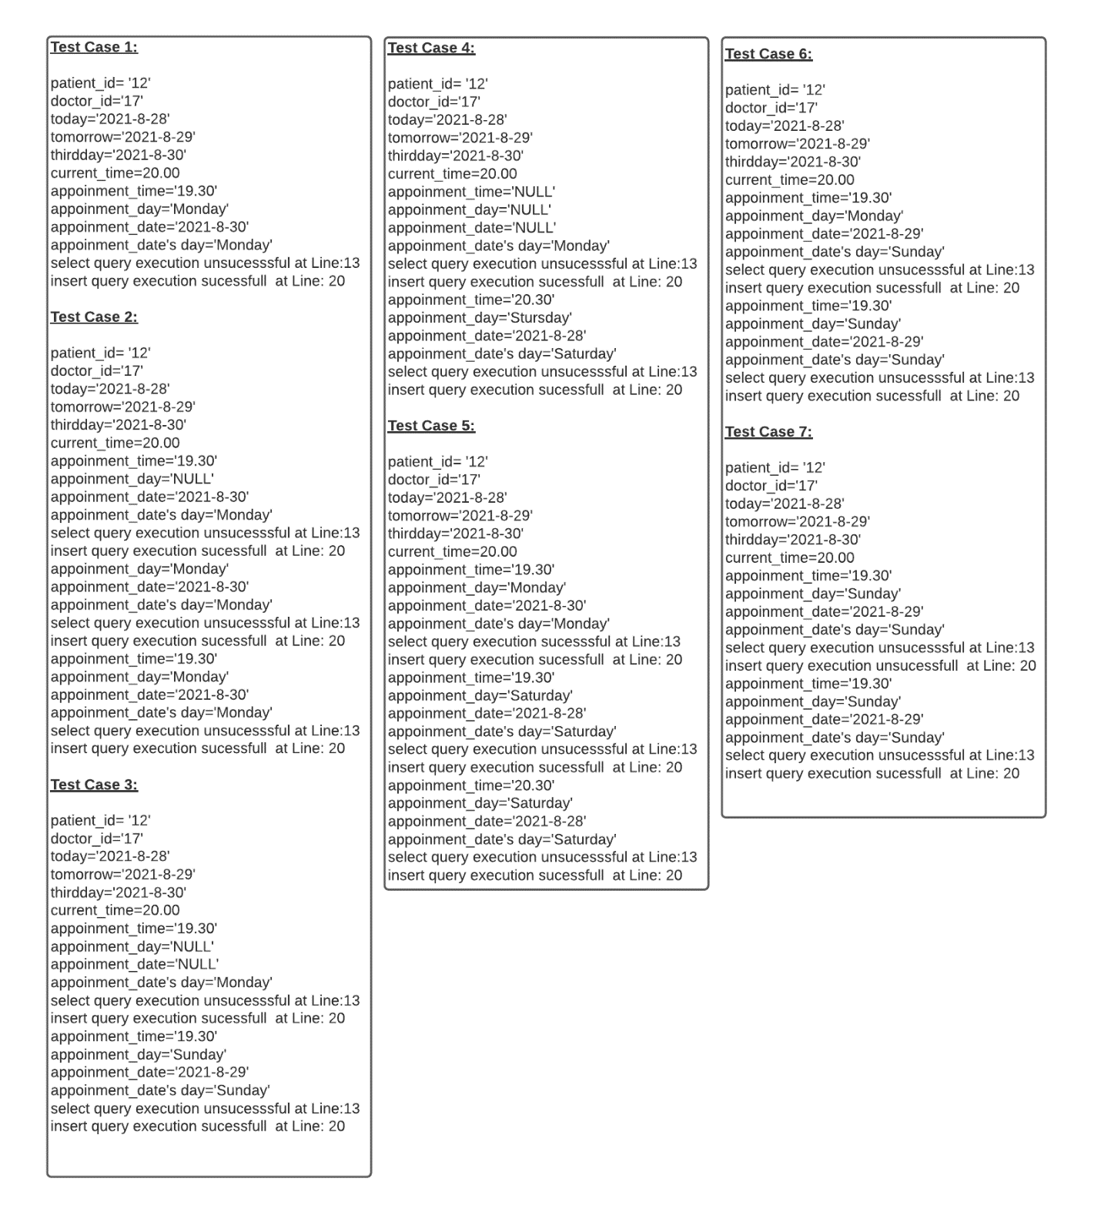
path Coverage

Slide 38
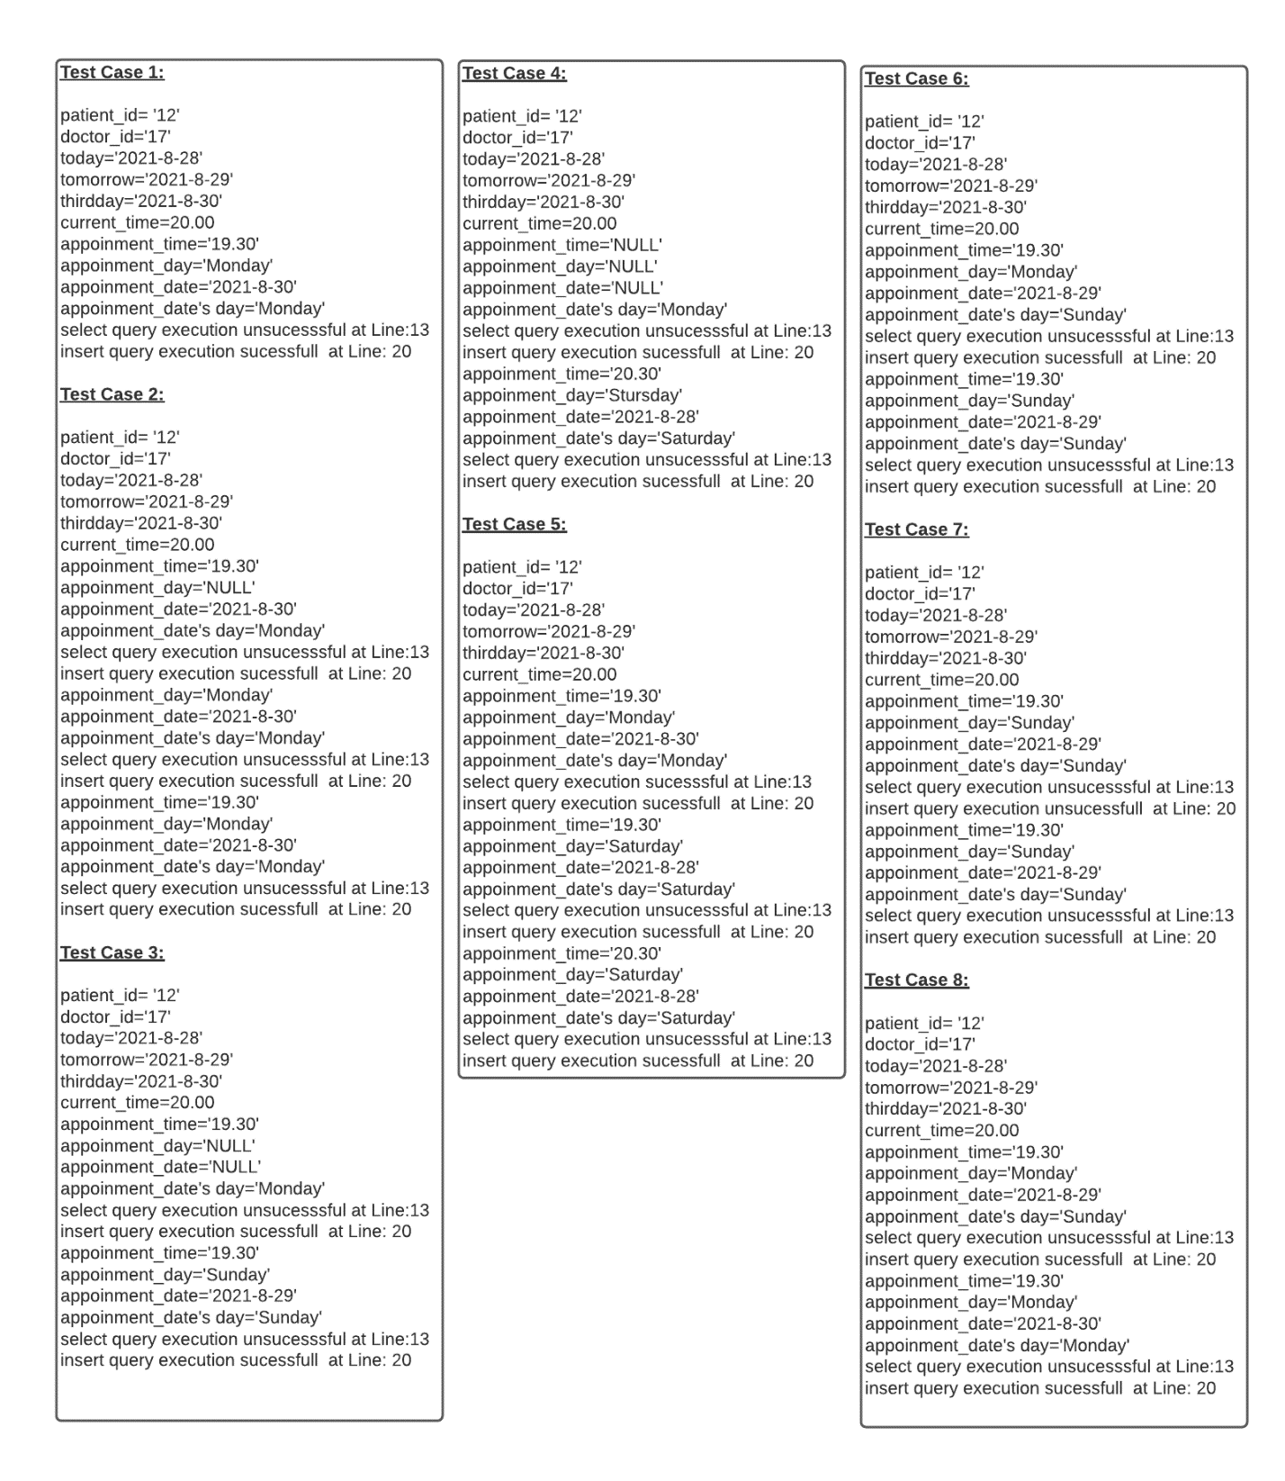
path Coverage

Slide 39
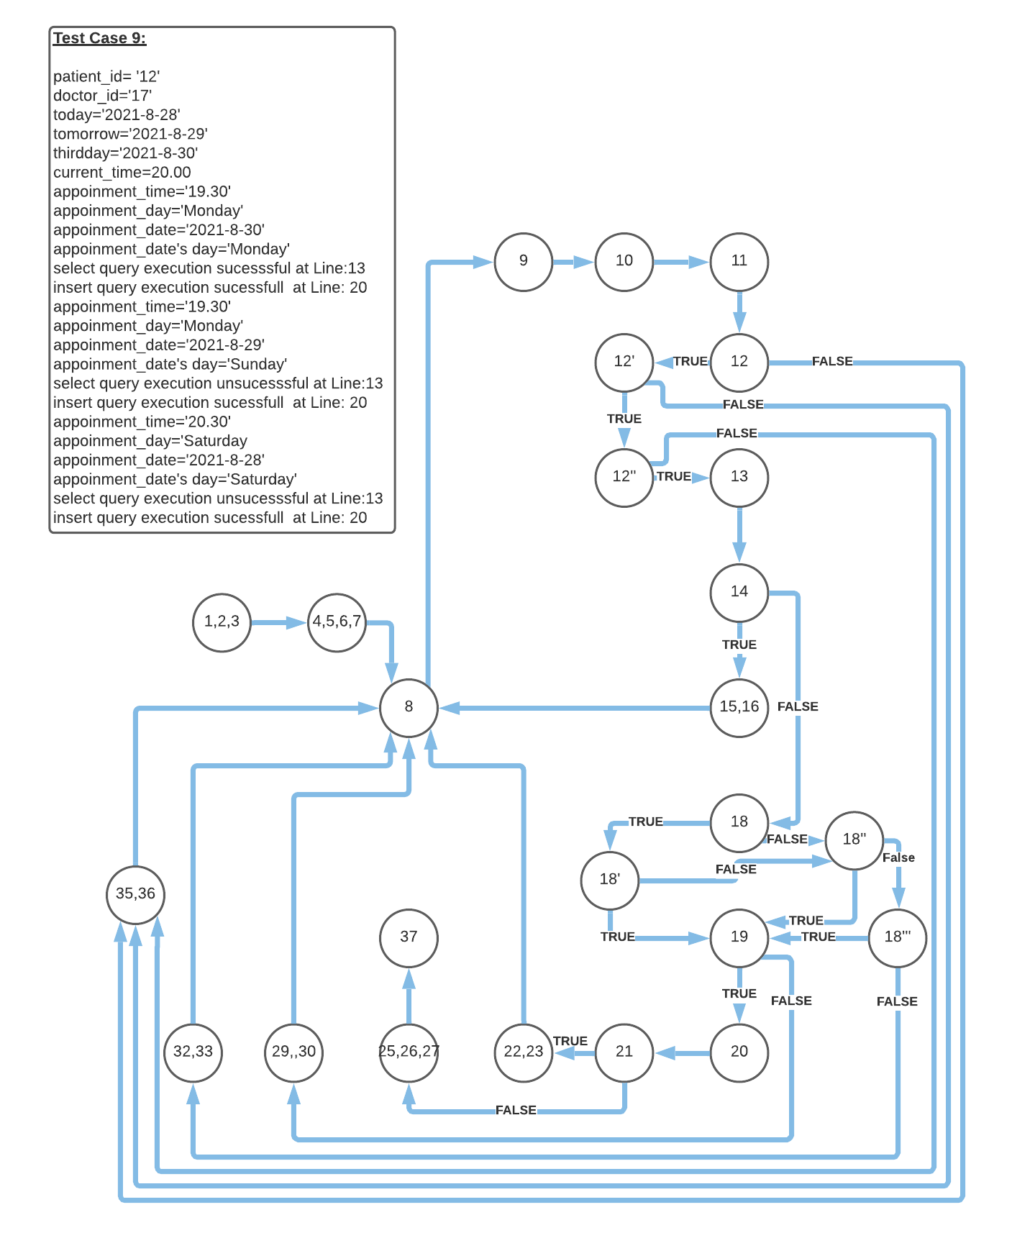
path Coverage

Slide 40
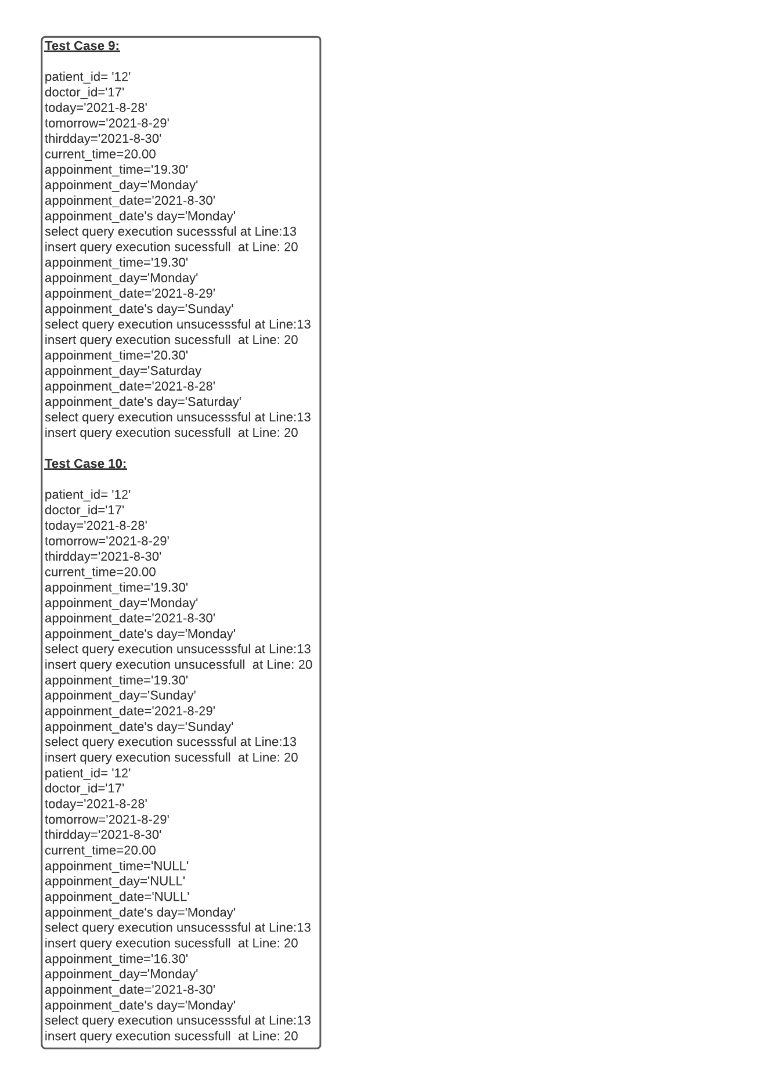
path Coverage

Slide 41
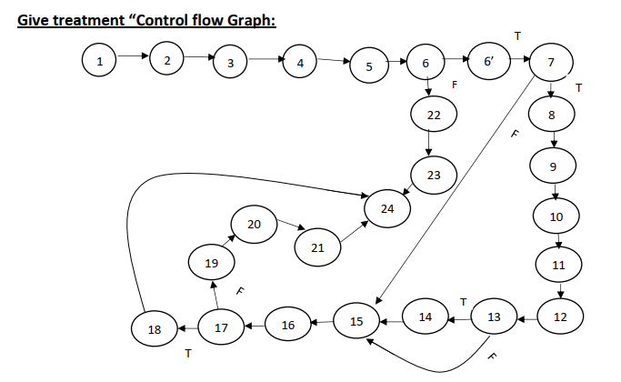
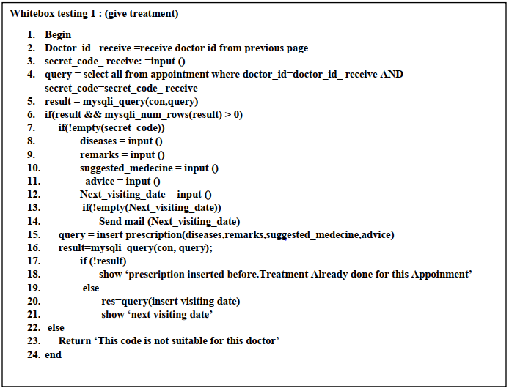
Whitebox Testing

Slide 42
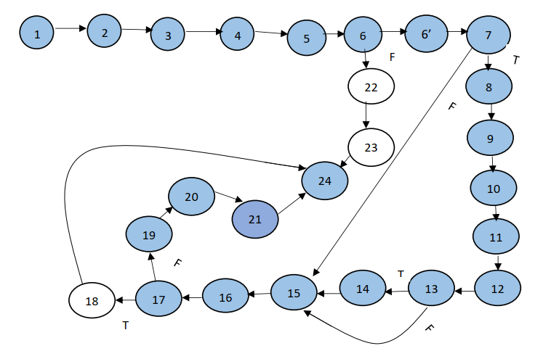
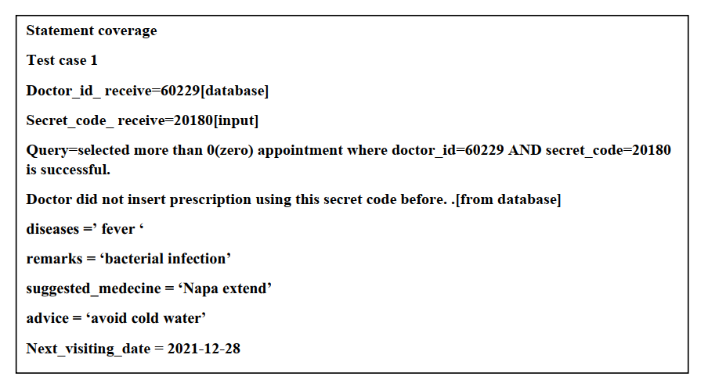
Statement Coverage

Slide 43


Statement Coverage

Slide 44


Statement Coverage

Slide 45


Edge Coverage

Slide 46


Edge Coverage

Slide 47


Edge Coverage

Slide 48


Edge Coverage

Slide 49


Edge Coverage

Slide 50


path Coverage

Slide 51


path Coverage

Slide 52


path Coverage

Slide 53


path Coverage

Slide 54


path Coverage

Slide 55

Ayshee
Shihab
Raunaq

